Slide 1
Rethinking academic leadership in a managerialist context: the collegium, the collective, and an ethic of care
Magda Fourie-Malherbe
Learning and Teaching Seminar
14 March 2018

Slide 2
Overview
Globalisation, neoliberalism & New Public Management
Implications for higher education systems
Organisational managerialism and implications for academic work
Academics’ responses to managerialism
The role of the academic leader in a managerialist context
Preserving the collegium
Promoting inclusivity through distributing leadership
Practicing an ethic of care
Towards soulful academic leadership?

Slide 3
Globalisation
"The age of globalisation began on the day the Berlin Wall came down. From that moment in 1989, the trends evident in the late 1970s and throughout the 1980s accelerated: the free movement of capital, people and goods; trickle-down economics; a much diminished role for nation states; and a belief that market forces, now unleashed, were unstoppable” (Larry Elliott, The Guardian, 26 June 2016).
a process by which national and regional economies, societies, and cultures have become integrated through the global network of trade, communication, immigration and transportation
more recently the term has been expanded to include a broader range of areas and activities such as culture, media, technology, socio-cultural, political, and even biological factors, e.g. climate change.

Slide 4
Neoliberalism
Neoliberalism is a particular element of globalisation constituting the form through which domestic and global economic relations are structured (Olssen & Peters 2005)
Neoliberalism has become the ‘new common sense’
It replaces the logic of exchange with that of competition (Ball & Olmedo 2013) and…
… advances a new anthropology: homo economicus – the individual as an enterprising and competitive entrepreneur
“Inequality is recast as virtuous: a reward for utility and a generator of wealth…Efforts to create a more equal society are both counterproductive and morally corrosive” (Monbiot 2016)

Slide 5
Neoliberalism (2)
The term was coined as early as 1938 at a meeting in Paris
Neoliberal ideas began to enter the mainstream in the 1970s, particularly after Reagan and Thatcher took power: “massive tax cuts for the rich, the crushing of trade unions, deregulation, privatization, outsourcing and competition in public services. Through the IMF, the World Bank, the Maastricht treaty and the World Trade Organisation, neoliberal policies were imposed … on much of the world” (Monbiot 2016).
The ideology of neoliberalism is manifested in systems as New Public Management (NPM)

Slide 6
Practical manifestations of neoliberalism (NPM) and its effects on higher education
Implications
Introduction of market-type mechanisms and competition /increasing importance of international rankings
Commodification of services/ higher education as a ‘commodity’
Focus on value for money and doing more with less (efficiency)/ decline in public funding for higher education
Adoption of an entrepreneurial culture/growth in third, fourth and fifth stream income
Central regulation and control/increasing accountability requirements of universities
Shift of priorities from universalism to individualism/higher education as a public or a private good?
Emphasis on service quality, consumer orientation and choice/the student as consumer
Growth of contractual relationships (e.g. purchaser-provider)/contract research

Slide 7
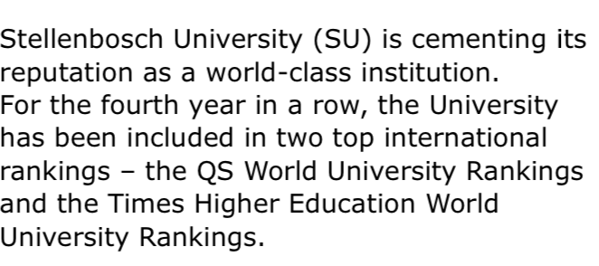

Slide 9
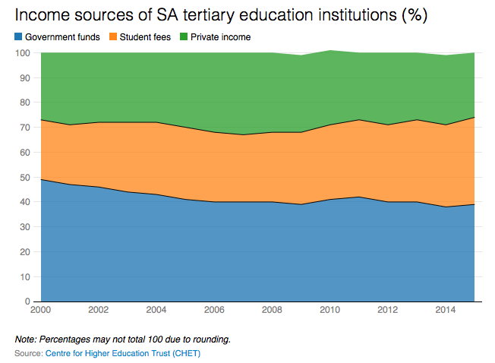

Slide 11
Implications of neoliberalism for academic work
The effect of de-professionalization: “Neoliberalism systematically deconstructs the space in terms of which professional autonomy is exercised” (Olssen & Peters 2005)
A shift from collegial or democratic governance in flat structures, to hierarchical models based on dictated management specifications of job performance
The implementation of academic restructuring initiatives in response to market and state
Increasing specifications by management over workloads, programmes, academic structures
Erosion of traditional conceptions of professional autonomy over work in relation to both teaching and research(Olssen & Peters, 2005)
Serving the needs of society by supplying suitably trained graduates but not necessarily valuing the role of the university to critique the external forces driving these changes (Kenny, 2009)

Slide 12
New executive positions (and salaries)
Appointments, not elections
Decisions and policies
Regulatory frameworks
Quick fixes (McKenna, The Conversation)

Slide 13
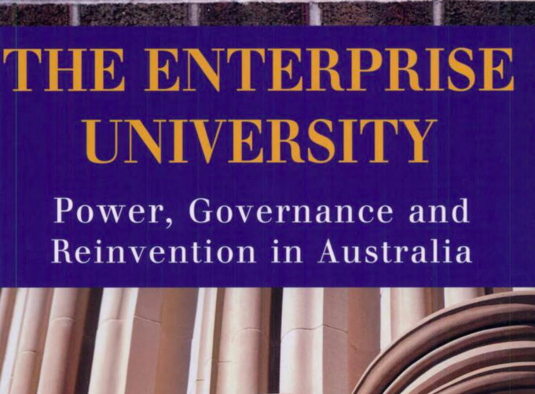

Slide 14
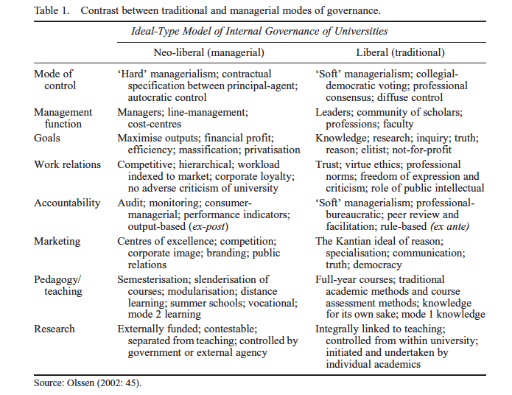
Managerialism as an organisational manifestation of neoliberal ideology (1)
, cited by Kolsaker 2008: 514)

Slide 15
Managerialism as an organisational manifestation of neoliberal ideology (2)
The adoption of a more business-like approach and private sector practices - establishment of a management culture (e.g. strategic planning and objective setting)
A greater separation of academic work and management activity with increased control and regulation of academic work by managers (e.g. performance management)
A perceived shift in authority from academics to managers and consequent weakening of the professional status of academics
An ethos of enterprise and emphasis on income generation – shift from inputs and processes to outcomes and outputs
More measurement and quantification of outputs (e.g. performance indicators)
Stronger market orientation, with increased competition for resources (Shepherd, 2017)

Slide 16
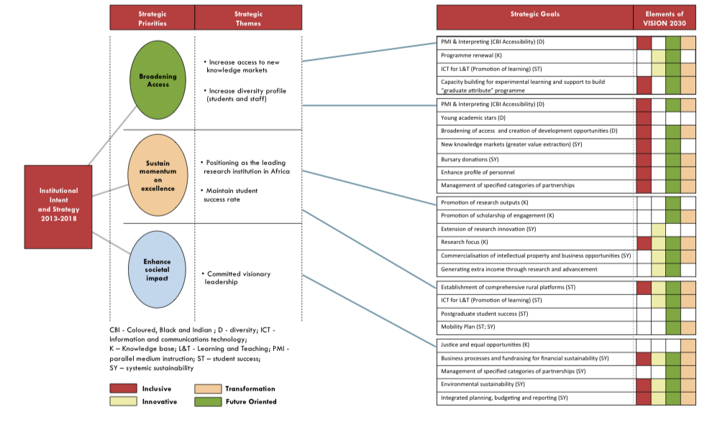

Slide 17
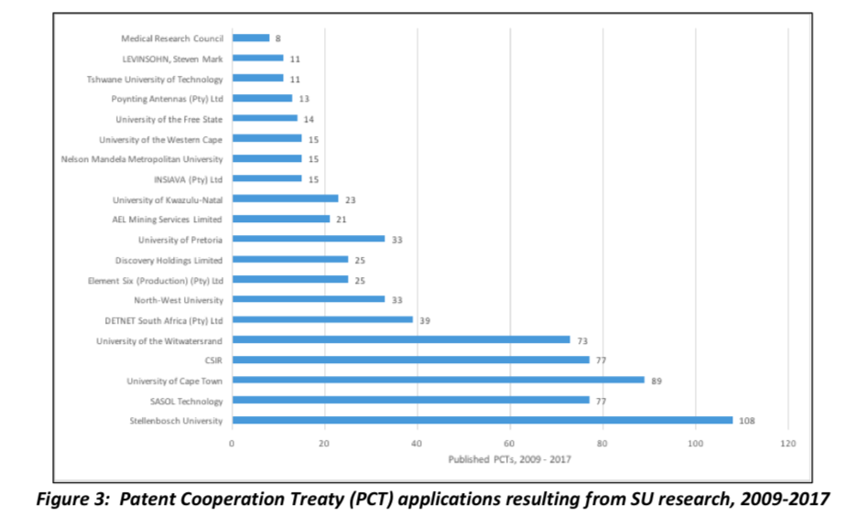

Slide 21
How do academics respond to a managerialist context? (1)
Kolsaker’s research in English universities shows that “academics are reasonably comfortable working within managerialist regimes, and that they are instrumental in sustaining them. Far from becoming disenchanted by the impact of managerialism upon their daily life, they appear, on the whole, to be making sense of and adapting to the changing environment whilst retaining a strong sense of professional identity” (2008: 522-523).

Slide 22
How do academics respond to a managerialist context? (2)
Research done in nine universities in the Netherlands, Sweden and the UK:
“Respondents in the three countries showed a clear dislike of the growing administration, the increasing competition for research funding, the obligation to fill in time-consuming grant applications and the heavier workload. Examples of frustration and stress are omnipresent. However, while this may have affected their commitment to the organisation, their involvement with the content of their work is still clearly visible. Most academics work very long hours. Particularly interesting was the way some respondents managed to cope with the obligations imposed upon them. They found ways to work around these stressful obligations and survived by maintaining their autonomy and academic freedom through demonstrating symbolic compliant or pragmatic behaviour” (my emphasis) (Teelken, 2012: 287)

Slide 23
How do academics respond to a managerialist context? (3)
A South African study by Webster and Mosoetsa (2001) differentiated the following responses from academics:
Reconfigured relationship with management – employees rather than colleagues
Increase in the intensity of work – change in the nature of work due to changing student populations, pressure to publish, and devolution of administrative functions
Loss of shared identity and sense of community
Feelings of powerlessness in the face of change
Increase in emotional labour (surface acting and deep acting)

Slide 24
How do academics respond to a managerialist context? (4)
Webster and Mosoetsa (2001) conclude as follows:
“We have suggested that academics face a demand overload. Faced by these demands many have become deeply pessimistic about their future in the academic workplace. Some are attempting to exit, either by leaving the university for the private or public sector, or by moving into managerial jobs in the university or fulltime research posts. This is an avoidance mechanism and not a solution to the demands facing academics at the chalk face. However we have also identified a small group who have responded to these demands in innovative ways. The difficulty is ensuring that these activities strengthen what Clark refers to as “the academic heartland.” The challenge, in the words of Colin Bundy, is to “fuse managerial imperatives with academic priorities” (Bundy, 1999:11).

Slide 26
Role of the academic leader in a managerialist context
“’Academic leaders’ are needed at all levels to restore some balance to the power structures in higher education and to facilitate the contribution of academics to effective policy and strategy”. (Kenny, 2009)

Slide 27
Preserving the collegium
Protection of the integrity of academic work against the excesses of efficiency driven reforms.
This extended role for academics could be conceptualized within a ‘fifth scholarship’ that explicitly focuses on professional academic leadership” This conception of academia goes beyond previous ideas of ‘service’ or collegiality.
It involves an active role for academic leadership ensuring the decision-making process within their organizations also accounts for the issues of concern to all academics, because they cut across institutional and disciplinary boundaries (Kenny 2009)

Slide 28
Preserving the collegium (2)
The collegium is NOT about creating constraining commonalities or emphasizing lowest common denominators
“ …creating the collegium is individual commitment to a shared community of purpose and rough agreement on standards of excellence in teaching, research, and service”
“…the commitment and agreement to work together in and through disagreements, to engage one another…” (Bennett, 1998:30)

Slide 29
Preserving the collegium (3)
“Collegiality does mean recognizing serious academic obligations to each other and participation in the academic life of the institution. It means working with colleagues to develop appropriate expectations: expectations that each person attend to the work of others (their teaching, scholarship, and service) and judge that work by criteria used for one’s own work and vice versa. Collegiality requires intellectual reciprocity with colleagues” (Bennet 1998: 125) (my emphasis)

Slide 30
Distributing leadership
Distributed leadership comprises a view of leadership as less the property of individuals, and more as the contextualised outcome of interactive, rather than unidirectional, causal process (Gronn 2002)
Activity is distributed or ‘stretched over’ multiple people and leadership is spread throughout the organisation – systems perspective
It is not about the agency and power of individuals but structurally conjoint agency, the concertive actions performed by pluralities of interdependent organisation members.

Slide 31
Distributing leadership (2)
Concertive action is more than numerical or additive action which represents the aggregated effect of a number of individuals contributing their initiative and expertise in different ways.
Concertive action is about the additional dynamic which is the product of conjoint activity – the outcome is a product that is greater than the sum of their individual actions

Slide 32
Distributing leadership (3)
Three patterns of concertive action:
spontaneous collaboration: leadership practice arises in response to particular problems and requirements - people with different skills and attributes interact in productive relationships to bring about a solution or complete a task of common interest
role sharing: intuitive working relations - two or more people work constructively within implicit frameworks of understanding – leadership changes as collaborators utilize each other’s skills and attributes to complete different aspects of a task – interdependency and reliance on each other - mutual trust is the key factor
-formal relationships: working together in agreed structures, enabling leadership roles to be officially recognized – institutionalised practice

Slide 33
Distributed leadership (4)
It may be top-down when senior leaders distribute leadership functions or when leaders share power and responsibilities among members of the institutional community
It may be bottom-up and spontaneous when collaborating teams of professionals work together to build networks within their institutions and with their communities
It leads to a division of labour that takes account of the skills and attributes of community members and the requirements for leadership on specific aspects of a task

Slide 34
Distributing leadership (5)
Three distinctive elements of distributed leadership:
Emergent property: leadership is an emergent property of a group or network of interacting individuals – this contrasts with leadership as a phenomenon which arises from the individual.
Openness of boundaries: it is predisposed to widen the conventional net of leaders – which groups or individuals are to be seen as contributors to leadership?
Leadership according to expertise: varieties of expertise are distributed across the many, not the few – numerous, distinct, germane perspectives and capabilities can be found in individuals spread throughout the organisation – if these are brought together, it is possible to forge a concertive dynamic which represents more than the sum of the individual contributions

Slide 35
Distributing leadership (6)
“…leadership is about learning together and constructing meaning and knowledge collectively and collaboratively. It involves opportunities to surface and mediate perceptions, values, beliefs, information and assumptions through continuing conversations. It means generating ideas together; seeking to reflect upon and make sense of work in the light of shared beliefs and new information; and creating actions that grow out of these new understandings. It implies that leadership is socially constructed and culturally sensitive. It does not imply a leader/follower divide, neither does it point towards the leadership potential of just one person.” (Harris 2003, cited by Bolden 2007).

Slide 36
Practicing an ethic of care
An ethic of care is defined as “moral reasoning that derives from a concern for others and a desire to maintain thoughtful mutual relationships with those affected by one’s actions” (Derry 2005: 65).
“The concern of this approach is the responsibility of the individual to respond to another in the other’s terms, acting out of care for the other person.” (Gilligan, 1982: 65)
“This is distinct from conceptions of morality as justice in that it does not attempt to follow impartial rules or ensure equitable treatment. It focuses on responsiveness to another’s needs. It also includes caring for oneself in a nurturing rather than a self-maximising way” (Gilligan, 1982: 65).

Slide 37
Practicing an ethic of care (2)
“Thus, the essence of caring becomes a focus on acceptance of the other, both in his or her current state, and as one capable of growth. Nurturing the development of the one cared-for becomes the critical activity in caring relationships” (Liedtka 2005: 69)
Care is “more than simply good intentions, it is deep and thoughtful knowledge” of situations in combination with activities and attitudes (my emphasis) (Gastmans 2006, cited by Herman, 2015)

Slide 38
Distributing leadership
Preserving the collegium
Soulful academic
leadership
Practicing an ethic of care

Slide 39
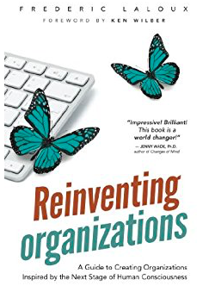
Soulful leadership
Source: Forbes.com

Slide 40
In conclusion
If we are serious about the future of the university can we afford NOT to preserve the collegium?
If we are serious about inclusivity can we afford NOT to practice distributed leadership?
If we are serious and honest about promoting social justice can we afford NOT to adopt an ethic of care?
Is it possible to be soulful academic leaders?

Slide 41
Thank you for your kind attention!
Questions?
Discussion?

Slide 42
List of sources
Ball, Stephen J & Antonio Olmedo (2013) Care of the self, resistance and subjectivity under neoliberal governmentalities, Critical Studies in Education, 54:1, 85-96, DOI: 10.1080/17508487.2013.740678
Bennett, John B (1998) Collegial professionalism. The academy, individualism, and the common good. Phoenix, AR: American Council on Education and The Oryx Press.
Bolden, R (2007) Distributive leadership. University of Exeter. (https://business-school. exeter.ac.uk/documents/papers/management/2007/0702.pdf)
Derry, Robbin (2005) Care, ethics of. In: The Blackwell Encyclopedia of Management. Volume II Business Ethics (second edition), edited by Patricia H. Wehane & R. Edward Freeman, 65-68. Oxford: Blackwell.
Gilligan, Carol (1993) In a different voice. Psychological theory and women’s development. Cambridge, MA: Harvard University Press.
Gronn, Peter (2002) Distributed leadership as a unit of analysis, The Leadership Quarterly, 13, 423-451.
Herman, Nicoline (2015) The role of context in decision making about professional learning by lecturers at a research-intensive university. (Unpublished PhD dissertation) Stellenbosch: Stellenbosch University.
Kenny, John Daniel (2009) Managing a modern university: is it time for a rethink? Higher Education Research & Development, 28:6, 629-642.
Kolsaker, Ailsa (2008) Academic professionalism in the managerialist era: a study of English universities, Studies in Higher Education, 33:5, 513-525, DOI: 10.1080/03075070802372885

Slide 43
List of sources (2)
Liedtka, Jeanne M. 2005. Caring organizations. In: The Blackwell Encyclopedia of Management. Volume II Business Ethics (second edition), edited by Patricia H. Wehane & R. Edward Freeman, 68-70. Oxford: Blackwell.
McKenna, Sioux (2018) Here are five signs that universities are turning into corporations, The Conversation, 14 March 2018 (https://theconversation.com/here-are-five-signs-that-universities-)
Monbiot, George (2016) Neoliberalism – the ideology at the root of all our problems, The Guardian, Friday 15 April (https://www.theguardian.com/books/2016/apr/15/neoliberalism_)
NP-PSET (2018) Draft National Plan for Post-school Education and Training. Pretoria: Department of Higher Education and Training.
Mark Olssen & Michael A. Peters (2005) Neoliberalism, higher education and the knowledge economy: from the free market to knowledge capitalism, Journal of Education Policy, 20:3, 313-345, DOI: 10.1080/02680930500108718
Shepherd, Sue (2017) Managerialism: an ideal type, Studies in Higher Education, DOI: 10.1080/03075079.2017.1281239
Teelken, Christine (2012) Compliance or pragmatism: how do academics deal with managerialism in higher education? A comparative study in three countries, Studies in Higher Education, 37:3, 271-290, DOI: 10.1080/03075079.2010.511171
Webster, Edward & Sarah Mosoetsa (2001) At the chalk face: managerialism and the changing academic workplace 1995-2001, (CHET commissioned paper)

