Slide 1
How do I submit a case report/series application?
Navigating the online ethics application system
Video compiled and recorded by Dr Debbie Marais, September 2021

Slide 2
Important links
The link to log on to your application to submit a progress report: www.applyethics.sun.ac.za
The link to the Health Research Ethics Office where all the forms, instructions, submission dates, and resource documents can be found: www.sun.ac.za/healthresearchethics
The link to the Undergraduate Research Ethics Committee (UREC) pages where guidance and information about UREC applications can be found: http://www.sun.ac.za/english/faculty/healthsciences/rdsd/Pages/Undergraduate_research/Undergraduate-Research-Ethics-Committee.aspx

Slide 3
Creating the online application form
Log in to the Infonetica ethics application site using your SUN ID and password: www.applyethics.sun.ac.za
Only SUN ID-registered applicants will be able to access the online ethics application system with their SU username and password
If you are not yet registered, you will need to request a SUN ID registration from your department/division
Note that the SUN-ID registration process to obtain an SU username and password is not an ethics process and is not handled by the ethics office

Slide 4
Why is it important to have a SUN-ID?
When you log in with your SUN-ID (SU username and password) and enter your SU UT number, the Infonetica system automatically pulls in your contact information from the HR and Student Affairs electronic systems
The email address that is pulled in from the HR or Student Affairs system will be the one that is used by the ethics office to communicate all feedback regarding your ethics application. The relevant department that you are registered with must also be correct.
It is therefore essential that you ensure that your correct department and contact details are loaded on the HR or Student Affairs electronic systems, in order for the correct information to be populated on Infonetica

Slide 5
Assistance with SUN-IDs, usernames & passwords
SUN-ID guidance: http://www.sun.ac.za/itservices/useradm/sunid.htm
Username guidance: http://www.sun.ac.za/itservices/useradm/usernames.htm
Password guidance: http://www.sun.ac.za/itservices/useradm/passwords.htm

Slide 6
Getting started
Make sure you leave enough time to complete the online application before the submission deadline
Check the submission deadlines online to ensure you submit on time (see HREC/UREC website: Submission dates). Applications must be submitted by 12:00 (midday) on the deadline
Make sure you have a SUN ID and password so that you can log on to the online application system (www.applyethics.sun.ac.za)
Ensure you have all the documents you need to attach to your online application form (see next slides). NB: The HoD of your/your supervisor’s department needs to sign an HoD signature page to be submitted with your application
Ensure that you have all the information you need to complete the electronic (online) application form (see next slides)

Slide 7
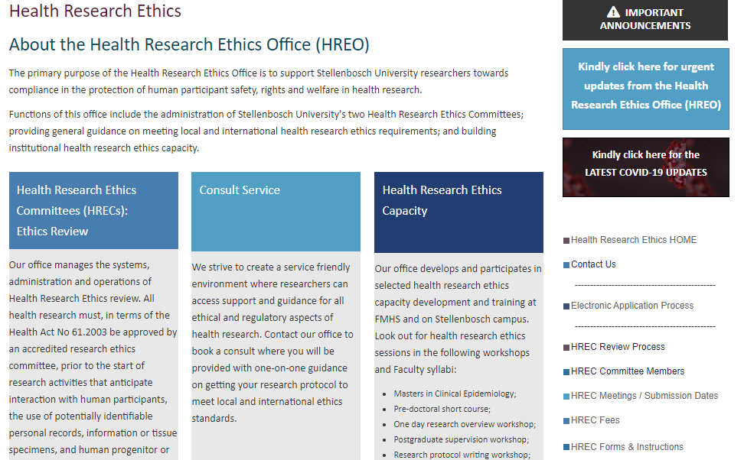

Slide 8
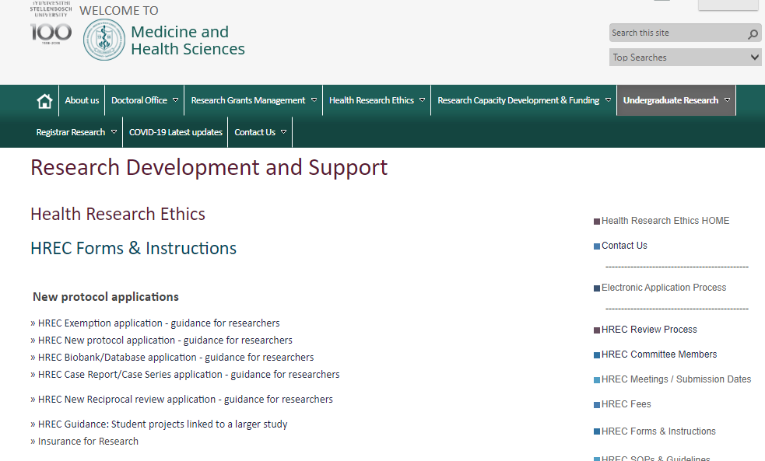

Slide 9
HREC guidance on case report applications
Case reports and series, by definition, tend to be about unique cases and therefore have the potential to reveal very personal information about patients and may even lead to their recognition by readers of the report/paper, particularly if photographs or other visual media are used. In general, informed consent must be obtained from each patient before publishing or presenting a case report or case series.

Slide 10
HREC guidance on case report applications
All case report/series applications should include:
Completed electronic HREC Case Report and Case Series Application Form submitted via the HREC online application portal, Infonetica© at: http://applyethics.sun.ac.za
Cover letter
Signed consent form for each patient (participant/subject of case) or their legally appointed representative, or a clear and adequately motivated justification for a waiver of informed consent for HREC consideration, and
The case report or draft article/presentation
Head of Department signature page
Note: all undergraduate and honours student applications follow this same procedure and will automatically be routed to UREC

Slide 11
Documents needed: Cover letter
The cover letter attached to your case report/series application should include at least the following:
Name, department/division and contact details of Principal Investigator (main applicant)
Names and departments/divisions of co-researchers and supervisors where applicable
Title of case report/series
Dates when case report/series was conducted/written
Location at which case report/series was conducted (e.g., Tygerberg Hospital)
Rationale for case report (this will be the same was the rationale included on the application form)
Intentions to disseminate case report/series (e.g., publish in xx journal)
Any other relevant information that might need to be noted to the ethics committee, particularly around consent, privacy and confidentiality of patient details

Slide 12

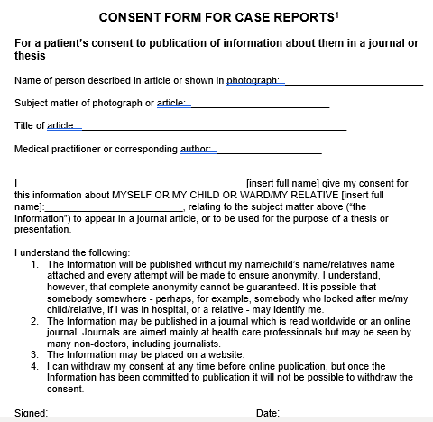
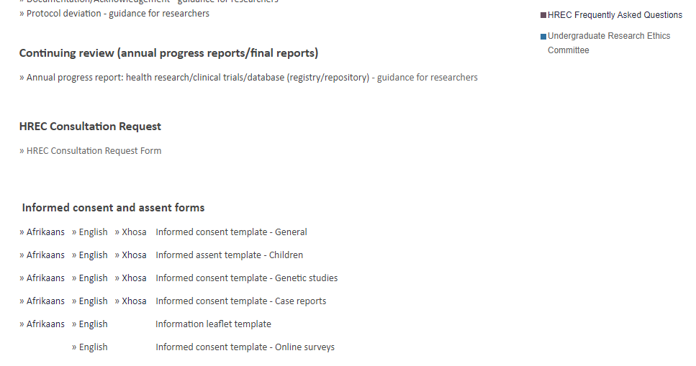
Notes:
An informed consent template for case reports/series can be found on the HREC forms and instructions page. This template must be adapted for relevance to your particular case and the particular patient. An assent form must also be created if the patient is a minor. Both parental consent and minor assent are required.
Translated into home language – templates available too

Slide 13
Documents needed: Consent form (1)
The consent form for your case report/series should include at least the following details:
Title of case report/series
Name of patient described or shown in case report/series
Aims of case report/series
Description of the text, photo, image, or other material (“information”) that will be included about the patient
Description of how the information will be used (e.g. its purpose – to be presented, published, examination) and who will have access to it
Description of how confidentiality of the information will be protected and limitations to this (e.g., may be possible to identify due to unique nature of illness / photograph etc.)
Information about voluntariness of participation / consent with no negative consequences

Slide 14
Documents needed: Consent form (2)
Consent form details continued:
Whether and how the patient will be remunerated
Potential risks and benefits of participation
How personal information will be managed in terms of POPIA
Name and full contact details (including department/division) of Principal Investigator
Name and full contact details of supervisor/s
Contact details for HREC/UREC should the patient wish to query/make complaint
NB: The consent form must be translated into the home language of the participant (patient/subject of case report/series)

Slide 15
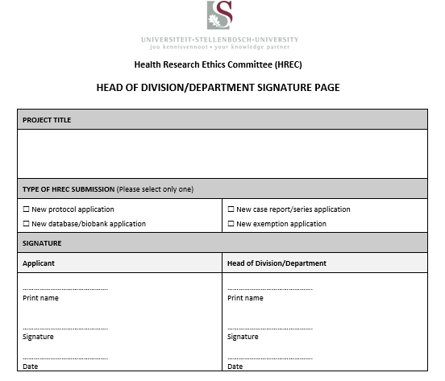
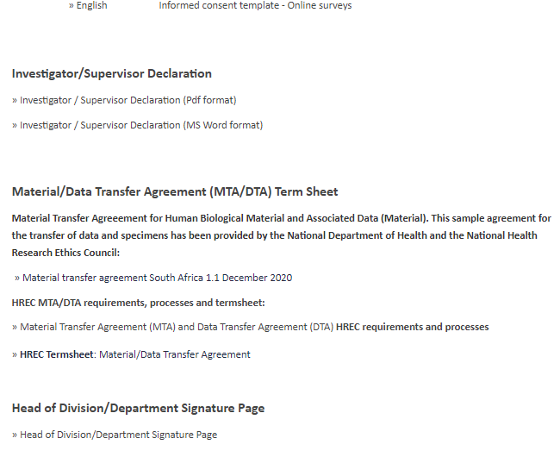

Slide 16
Information required on the application form (1)
Project (case report/series) title
Your contact details – you are the Principal Investigator
If you are a student, degree details
If you are a student, details of your supervisor
If you are registered with a professional body (e.g., HPCSA), your registration number
Head of Department/Division details
Notes:
More detail on this later as we go through the online form

Slide 17
Information required on the application form (2)
Where the case study/series was conducted
A rationale for the case report/series
Steps taken to protect patient confidentiality
Whether and how informed consent was obtained (if not, detail why not and include motivation for waiver of individual consent)

Slide 19
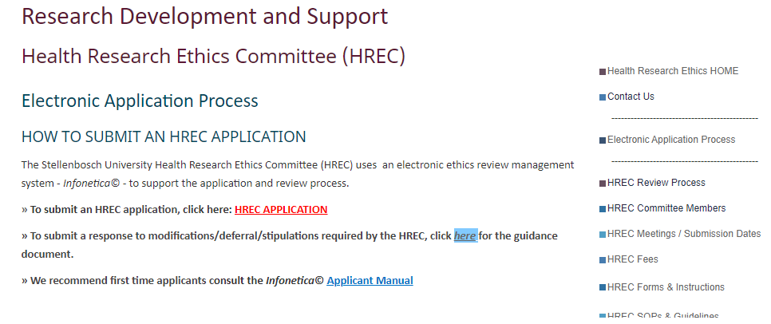

Slide 20
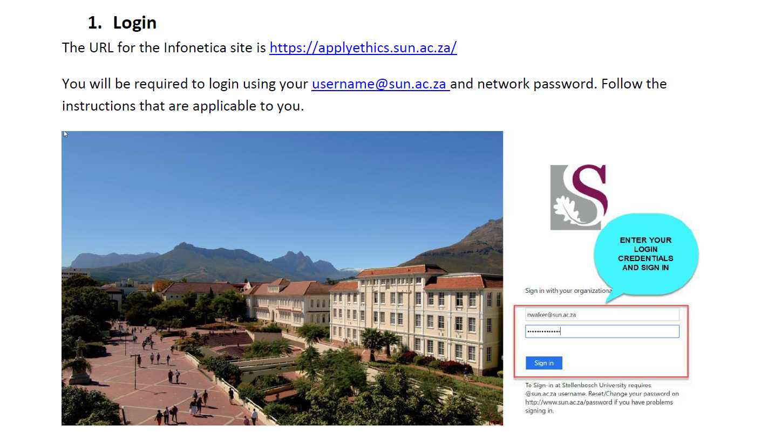
Creating the online application form

Slide 21
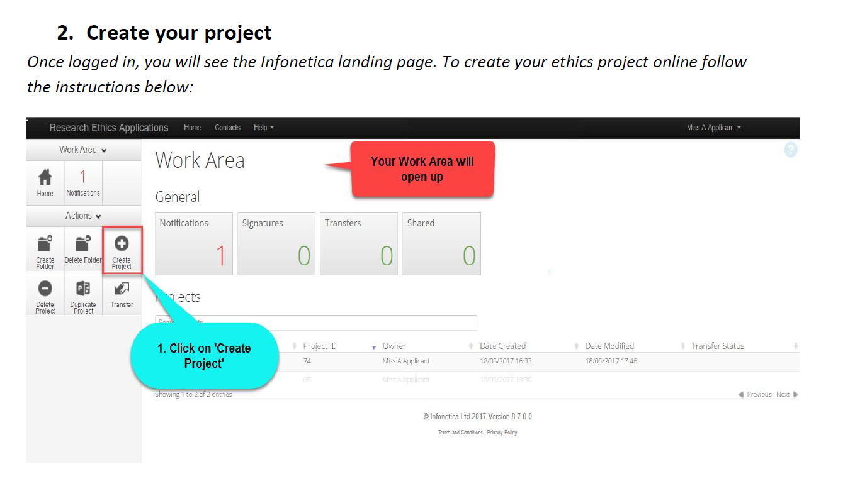
Once you have logged on, you need create a new application

Slide 22
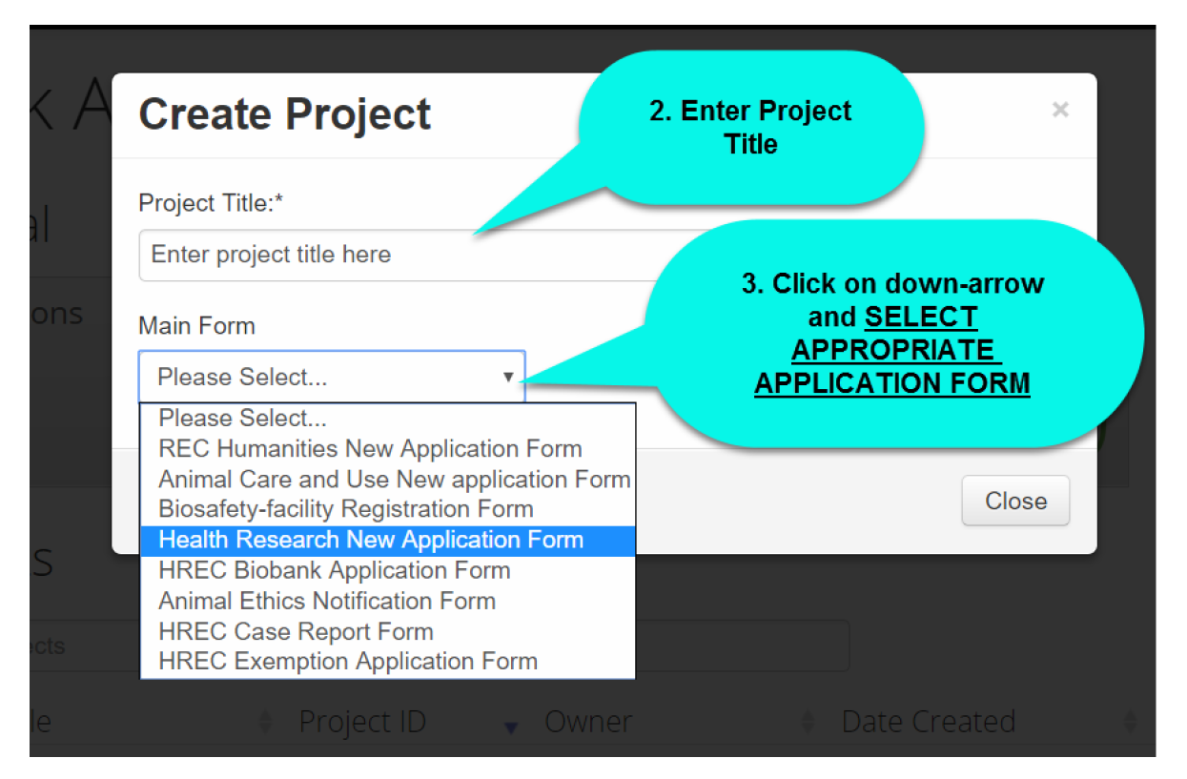
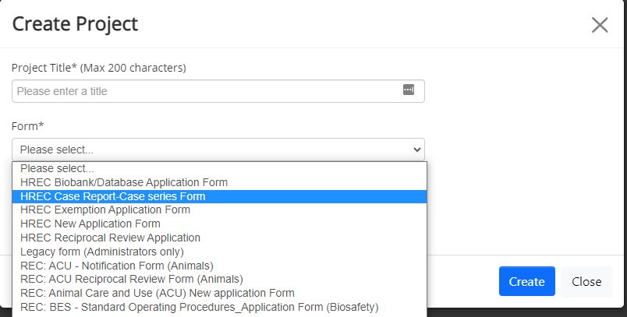
Enter title of case report/series
Select relevant form from dropdown menu

Slide 23
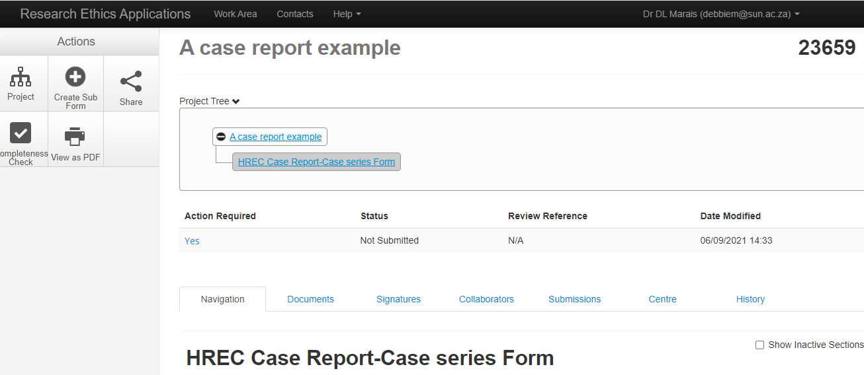
Application form has been created
Notes:
Point out useful things on this page. E.g. Project ID.

Slide 24
Sharing your application with your supervisor
Click on SHARE to share your application with your supervisor

Slide 25
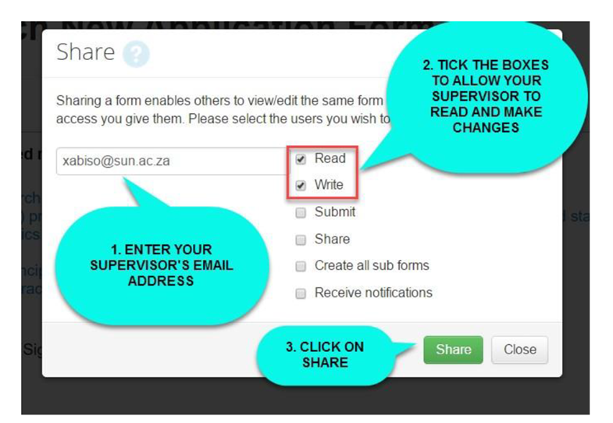
Sharing your application with your supervisor
Notes:
A notice will appear that your form has been shared successfully.
Your Supervisor will now be able to login, read and share comments with you while you are working on your form as shown below:

Slide 26
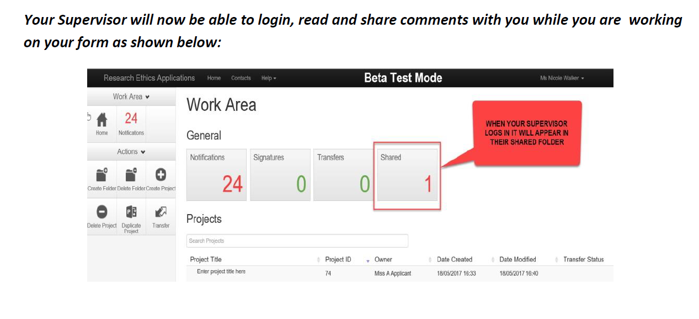
Sharing your application with your supervisor
Note: We are now back on the “Home” screen
Click on your project title to get back into your application

Slide 27
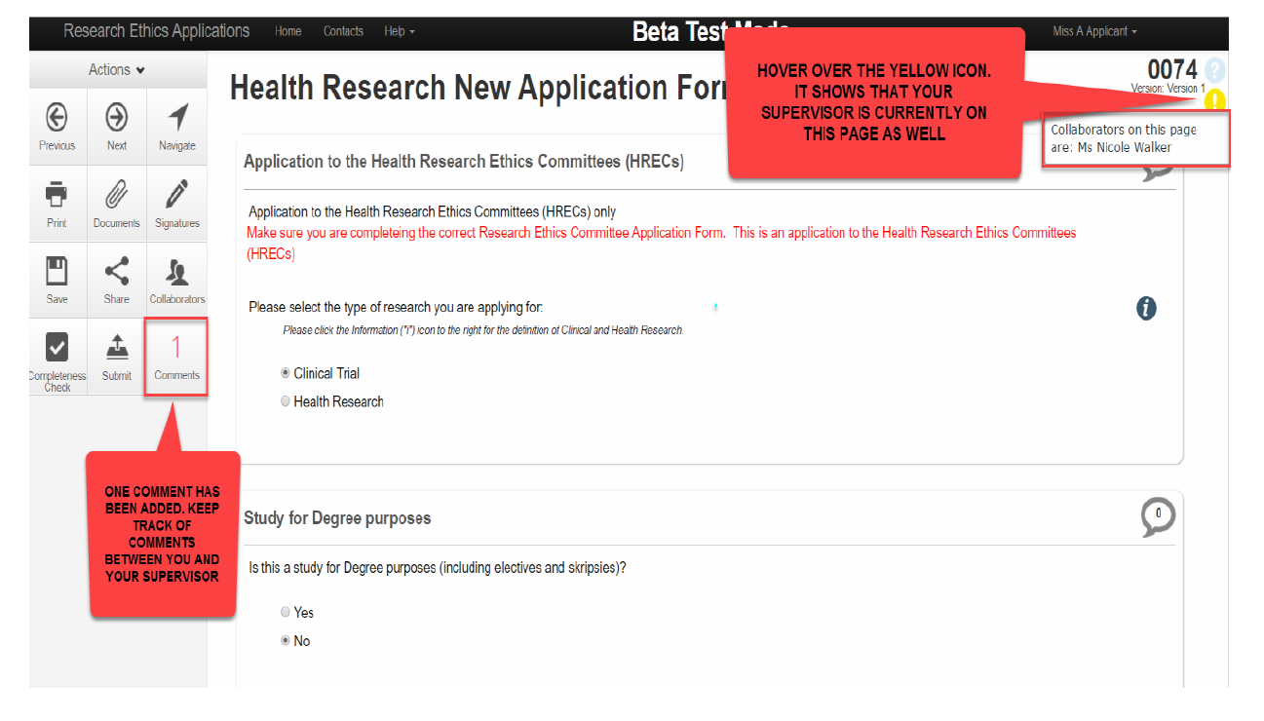
Sharing your application with your supervisor

Slide 28
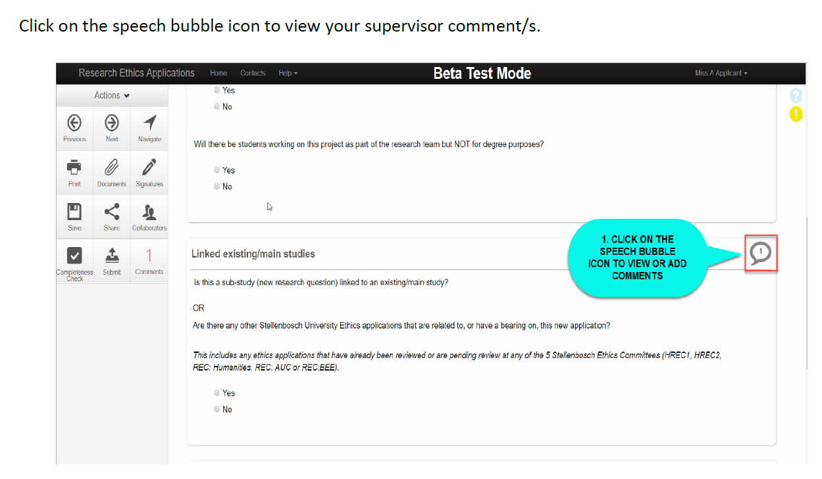
Sharing your application with your supervisor

Slide 29
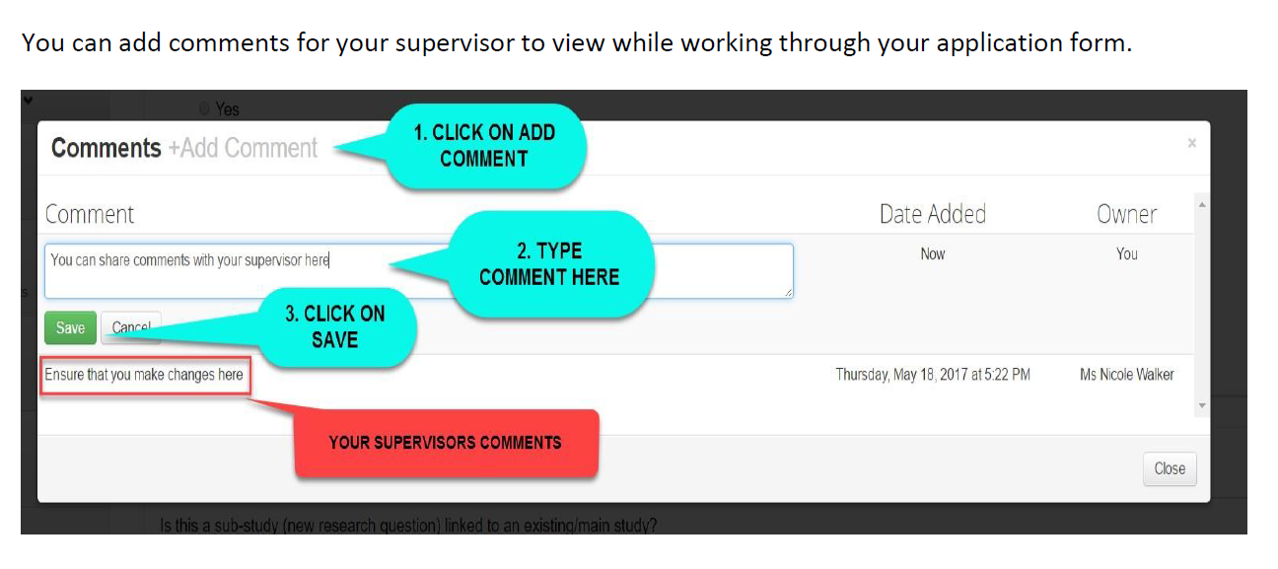
Sharing your application with your supervisor

Slide 30
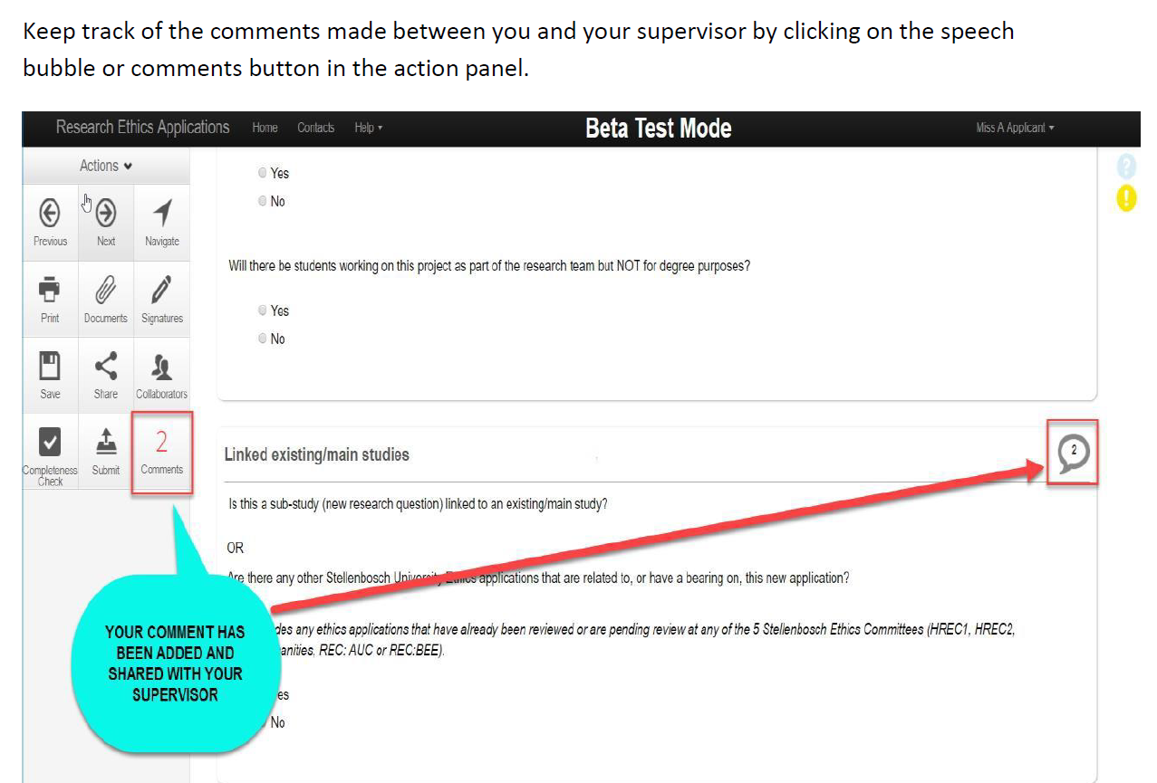
Sharing your application with your supervisor

Slide 31
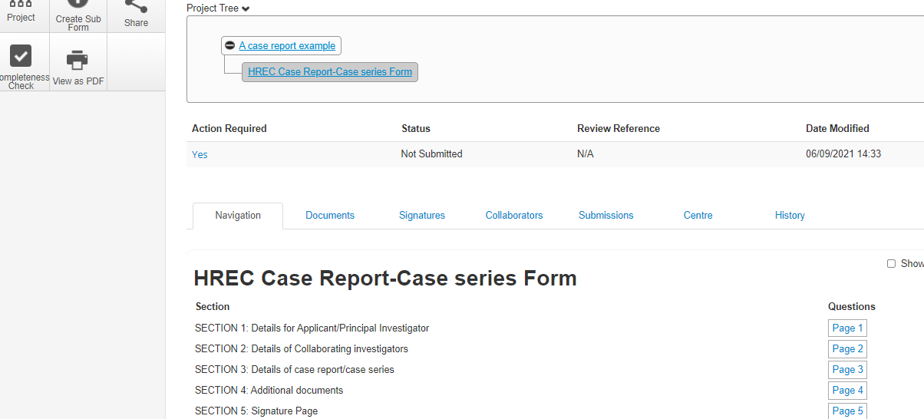
Completing your application form
These are the sections of the application form that you must complete
Notes:
The boxes you see under the heading HREC New Application Form are all the subsections of the application form that you need to complete. You can go into each section by clicking on the box.

Slide 32
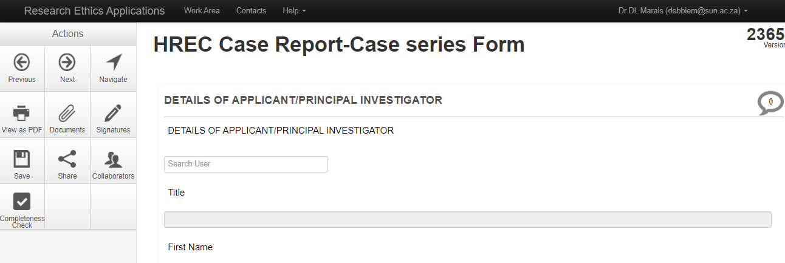
Completing your application form
Notes:
Click on the first box “filter questions”. This screen will open. Before we continue with answering the questions in the application form, it is useful to know what the different “action buttons” on the left hand side can be used for.

Slide 33
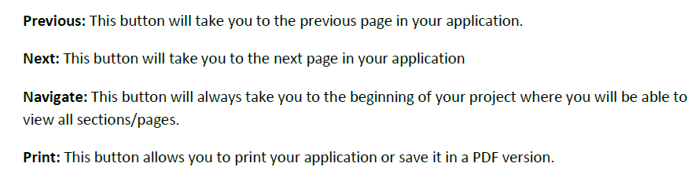
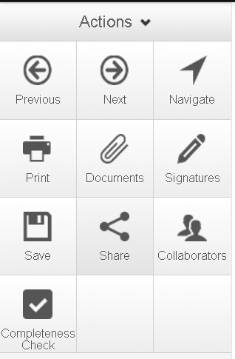
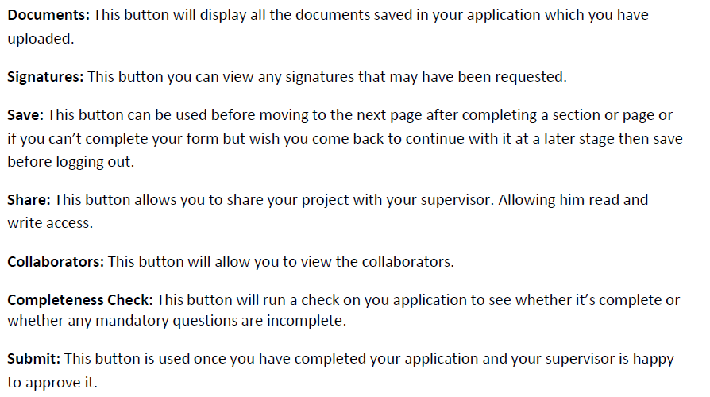
Action buttons

Slide 34
Completing your application form
Enter your name in “Search user” – the system should automatically pull in your details
Notes:
Fill in your details
This is where it is really important that your details on the HR or Student Affairs information systems are correct, as this information will automatically be pulled into these fields from those systems and you will be unable to change them manually if they are incorrect.

Slide 35
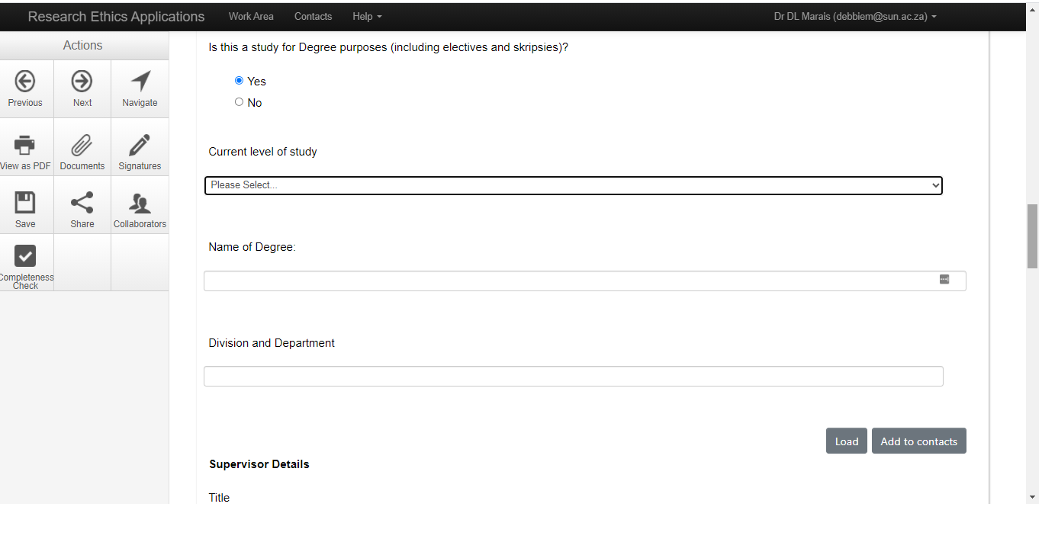
Completing your application form
Notes:
Scroll down on that page – if you enter YES for degree purposes, will ask you to put in current degree (UREC – note) and also your supervisor’s details

Slide 36
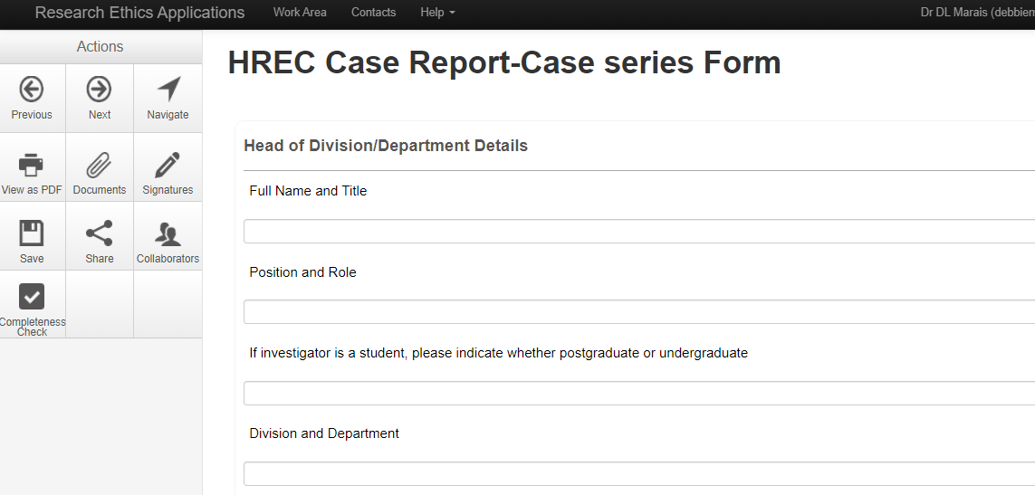
Completing your application form

Slide 37
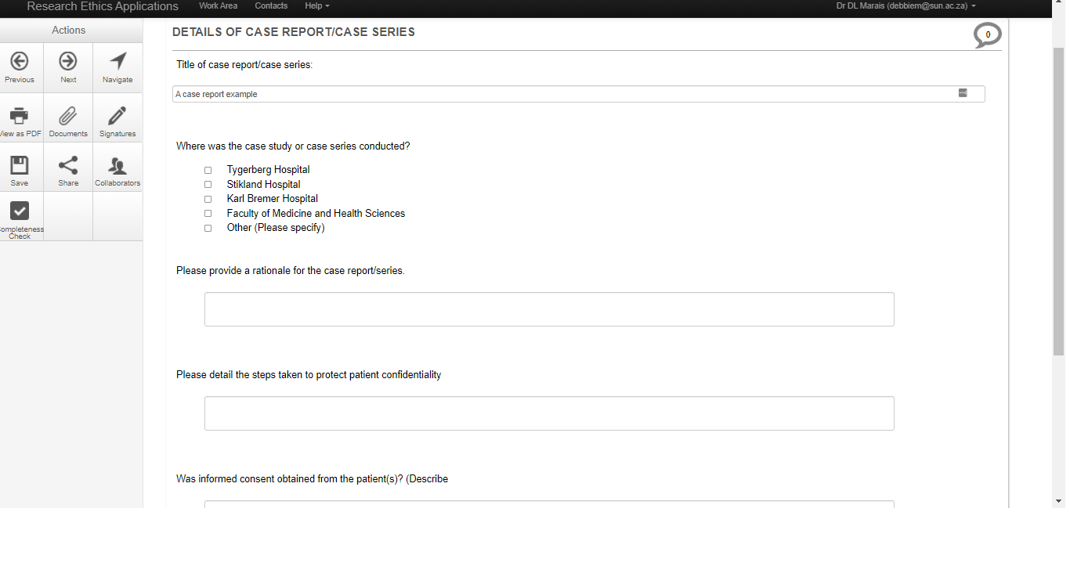
Completing your application form

Slide 38
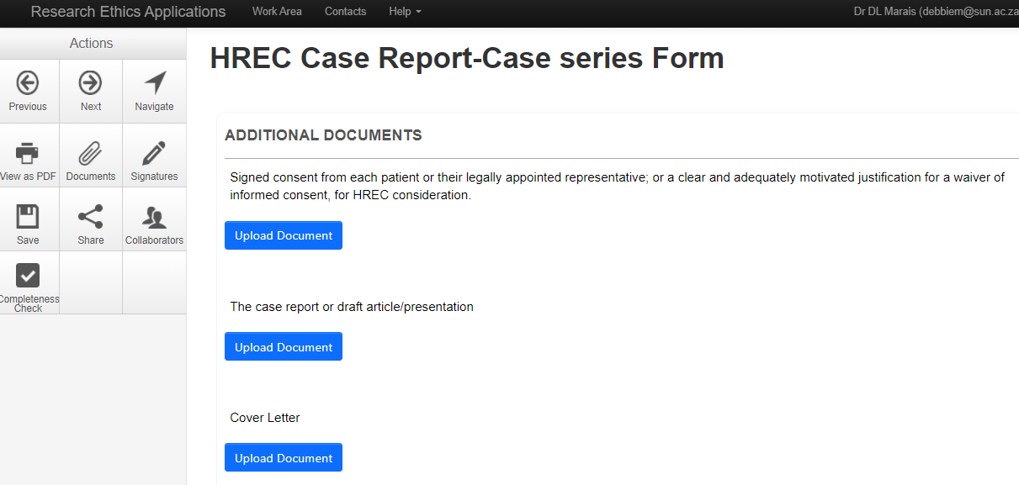
Completing your application form

Slide 39
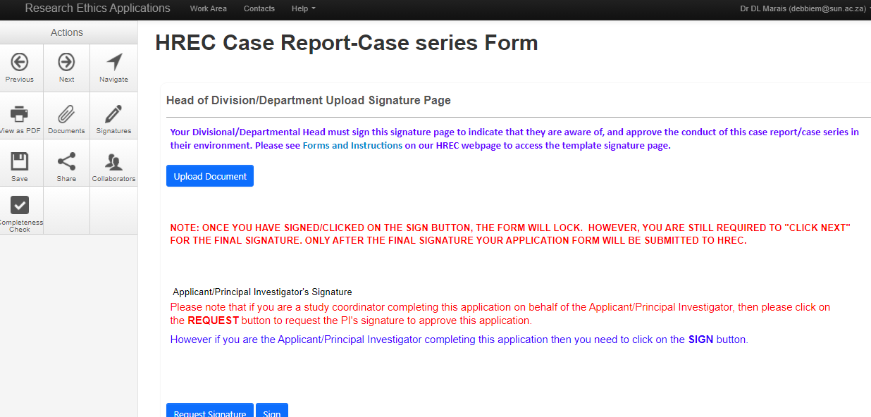
Completing your application form

Slide 40
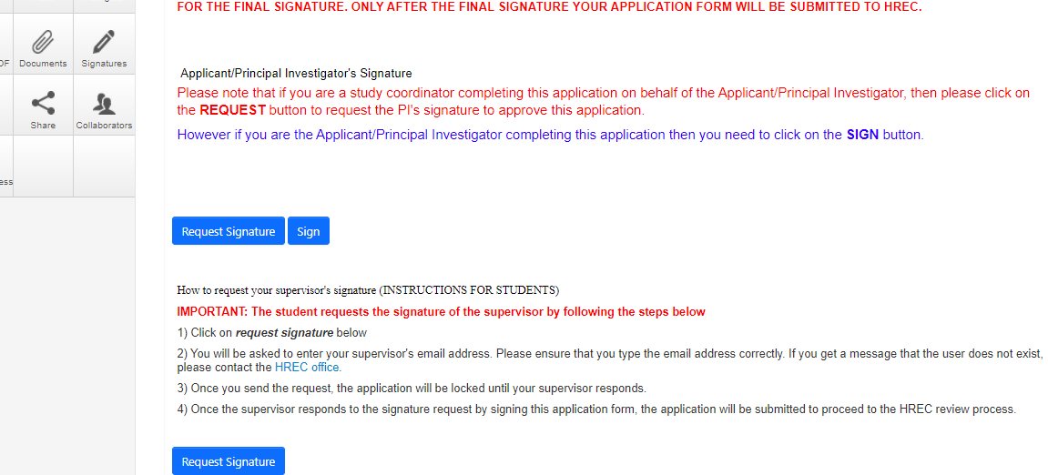
Completing your application form

Slide 41
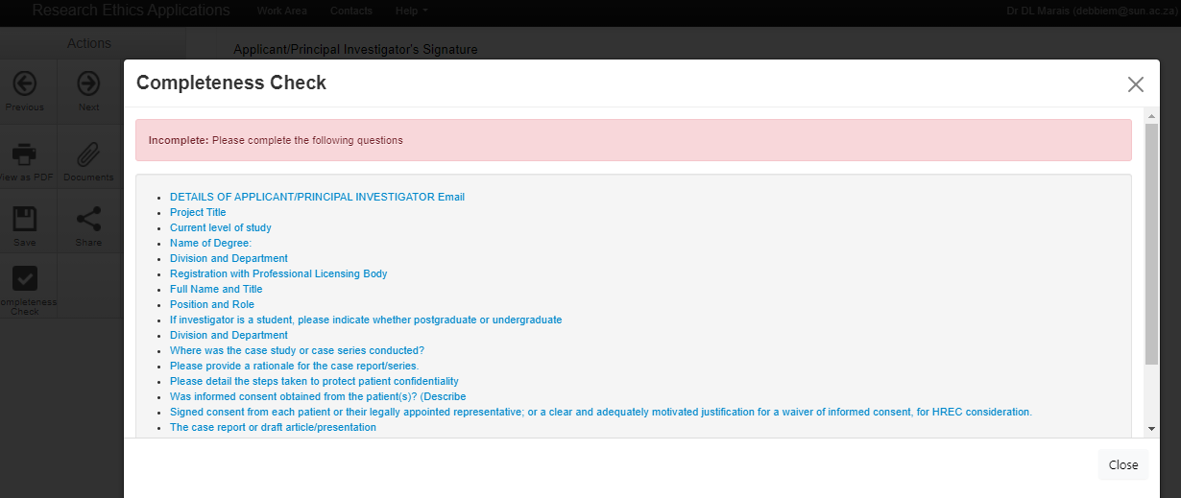
Completing your application form
Notes:
When I click on SIGN, this box pops up. You will see that because I was using this as an example, I did not complete all the questions or upload the required documents. Before the system will allow me to sign and submit the application to my supervisor for sign off, I will need to complete all the listed sections.

Slide 42
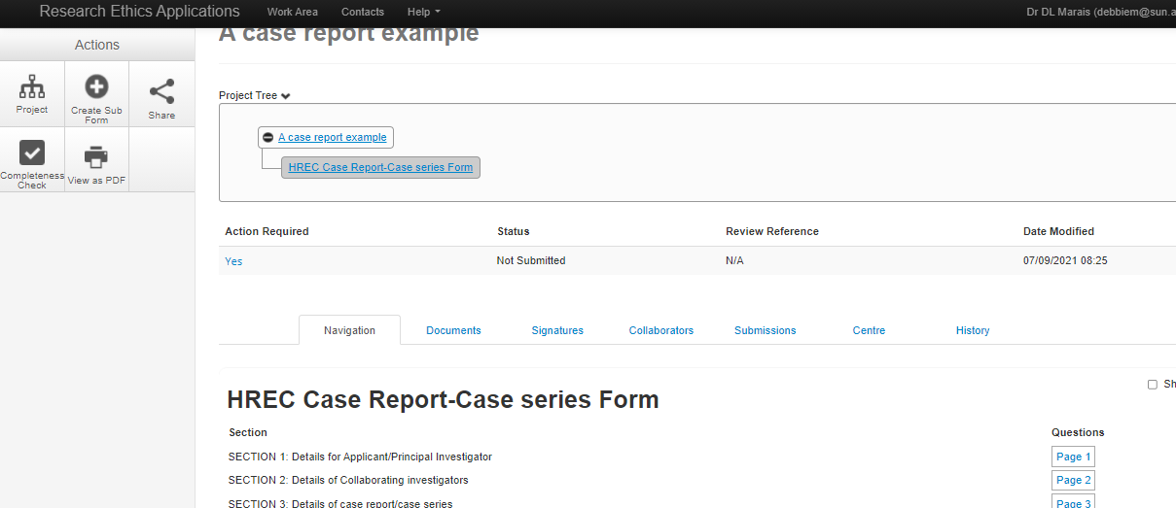
Completing your application form
Notes:
You can also do a Completeness Check at any point from the home screen of the application – click the Completeness Check action button on the left hand side
You can also see the status of your application – at the moment, it is showing that it is not submitted.

Slide 43
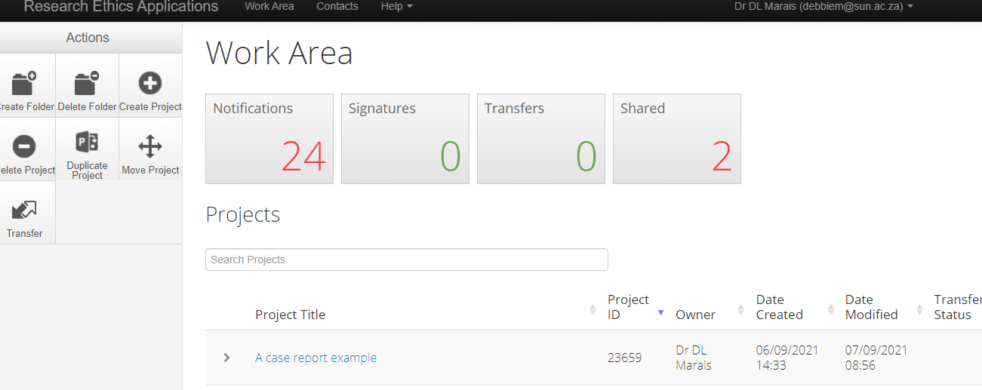
Checking the status of your application
Check on the status of your application by clicking on it
Notes:
Once you’ve requested supervisor’s signature, your form will be locked. Follow up with supervisor to make sure they’ve received the email notifying them to sign off on application. Only once they’ve signed off will the application be routed through to the ethics office – relevant HREC/UREC administrator

Slide 44
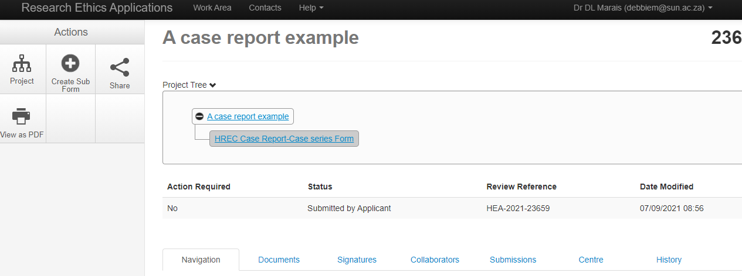
Checking the status of your application

Slide 45
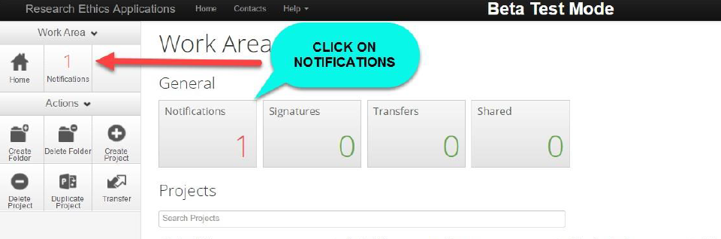
Checking the status of your application
Notes:
Once your application has been submitted, you will receive a notification – check emails. If you don’t receive this, your application may be ‘stuck’ somewhere – check in with the relevant HREC / UREC administrator to check if it has been received.

Slide 46
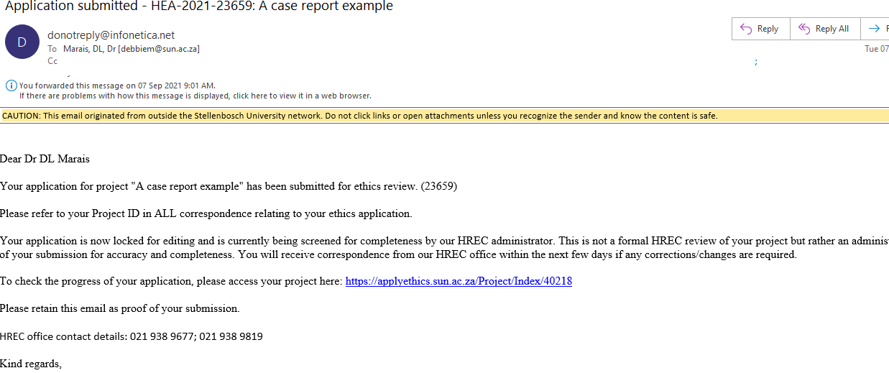

Slide 47
Support available
Infonetica guidance manual on submitting online applications:
http://www.sun.ac.za/english/faculty/healthsciences/rdsd/Pages/Ethics_application_package.aspx
Enquiries about the HREC/UREC application and review process:
  Ms Elvira Rohland (021 938 9677) elr@sun.a.ca (HREC)
  Mrs Ashleen Fortuin (021 938 9819) afortuin@sun.ac.za (HREC)
  Mrs Lauren Hendricks (021 938 9820) laurenv@sun.ac.za (UREC)
Enquiries about technical difficulties with the online application system:
  Ms Jennifer de Beer (021 808 9444) jad@sun.ac.za
Video compiled and recorded by Dr Debbie Marais, September 2021

