Slide 1
First-year Achievement Awards
Eerstejaarsprestasietoekennings
Amabhaso eMpumelelo waBafundi boNyaka wokuQala

Slide 2
Die Viserektor Leer en Onderrig, Prof Arnold Schoonwinkel,
bied die Eerstejaarsprestasietoekenningsgeleentheid aan die
toppresterende eerstejaarstudente van 2018 en hul genomineerde dosente
The Vice-Rector Learning and Teaching, Prof Arnold Schoonwinkel,
hosts the First-Year Achievement Awards event for the
top achieving first-year students of 2018 and their nominated lecturers

Slide 3
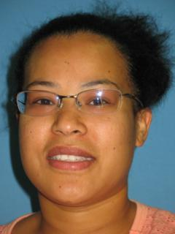
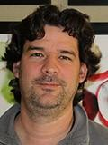
Portia Solomon (AgriSciences)
In Crop Production 151 (that a friend of mine dubbed “reflections”) you really provided me with the tools to aid me in my successful studies even in my envisioned postgraduate studies. During this module you taught me the importance of both personal and academic reflection.
Lecturer: Dr Michael Schmeisser
When I received the nomination letter, I immediately knew you out of a class of over 200 students. I realized that it was how your facial expressions spoke to me; that you were open to new ideas, interested and eager to learn and with a very strong sense of self.

Slide 4
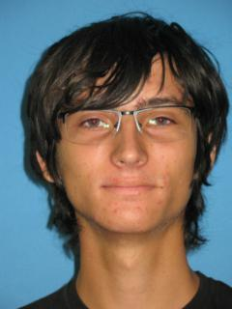
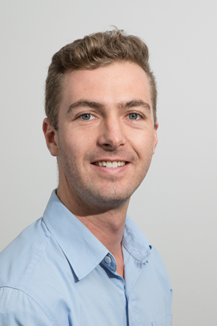
Thomas Hettasch (Engineering)
You did not train us to merely balance redox reactions; you taught us how to win at life. You showed an entire class the importance of persistence, of taking responsibility for your actions… you impacted an entire generation of young engineers.
Lecturer: Dr Robbie Pott
… while these results don’t define you, they do represent the manifestation of grit: perseverance, fortitude, dedication, and (I hope!) a healthy curiosity in the world.

Slide 5
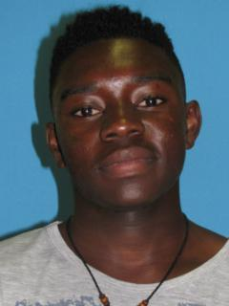
Kabanga Shakankale (AgriSciences)
It was often clear to me how you would connect the world of economics and how it affects the lives of ordinary people… the example of how you illustrated the proportions of different levels of education people in South Africa.
Lecturer: Dr Debra Shepherd
I certainly took notice of you and your clear and dedicated willingness to be engaged and personally involved with everything that was presented.

Slide 6
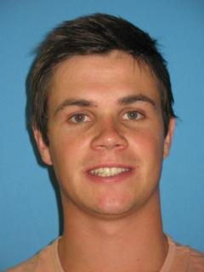
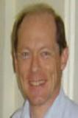
Bradley Moorcroft (Economic and Management Sciences)
I thoroughly enjoyed our interactions, both during lectures as well as during the tutorial session. You encouraged me to develop good class habits, to think from first principles, and to tackle problems in a logical and structured fashion.
Lecturer: Prof SJ Steel
Mental power and strength of character also imply responsibility; to develop talents wisely and responsibly, ultimately in the service of society and your community.

Slide 7
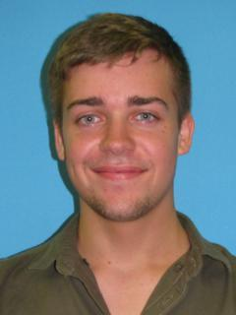
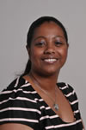
Hugo Uys (Law)
My first law class was Customary Law 171, where we met you. You instantaneously had a warmth about you. We immediately knew that you were here to help us, we only needed to ask.
Lecturer: Ms Ebrezia Johnson
My wish for you is that you will continue to mature and prosper as a law student, but that you will also enjoy studying law and see how law can actively change and better the lives of all South Africans.

Slide 8
A mind needs books, as a sword needs a whetstone, if it is to keep its edge. Tyrion Lannister – Game of Thrones

Slide 9
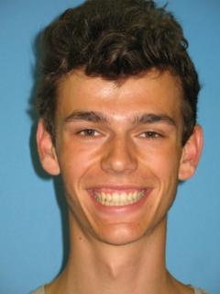
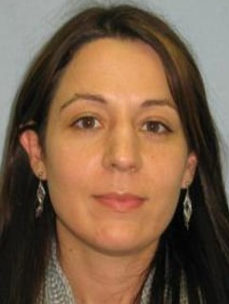
Matthys Carstens (Ekonomiese en Bestuurswetenskappe)
My gunsteling tipe onderwyser: altyd gewillig om vrae te beantwoord, oplettend oor haar studente se gemoedstoestande, uiters deeglik met die behandeling van werk en ‘n goeie titsel eksentriek.
Dosent: Dr KT Howell
Die tipe vrae wat jy gevra het en antwoorde wat jy gegee het gedurende die klastyd, het vir my gewys dat jy ‘n besondere talent en aanvoeling het vir wiskunde. My hoop is dat jy ‘n beroep sal vind waarin jy jou passie kan uitleef.

Slide 10
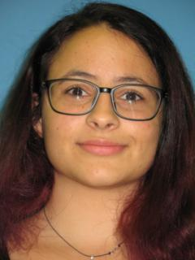
Zainab Khafif (Arts and Social Sciences)
Simply put, you made learning fun. Seeing that you had found something that you so noticeably loved to do every day was also something of an inspiration to me.
Lecturer: Ms Amy Daniels
You would have reached these heights without me. You are already intelligent, motivated and engaged – all the ingredients for success in academia. Still, thank you for the honour.

Slide 11
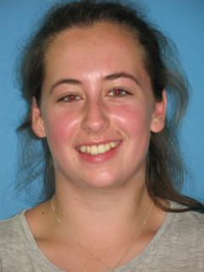
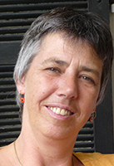
Anri Matthee (Arts and Social Sciences)
The assignments I completed in your class promoted originality, collaboration and creativity - principles that greatly improved my experience of German and reignited my motivation to study the language.
Lecturer: Dr Renate Riedner
Reading your texts was a joy and did not feel like work. You handed in exciting proofs of your symbolic competences and your creative mind; your gift for detailed observations and your ability to analyse complex symbolic interrelations…

Slide 12
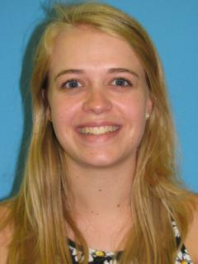
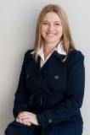
Petra Laubscher (Ekononiese en Bestuurswetenskappe)
En met rustige en logiese verduidelikings kon u selfs die ingewikkeldste vraag eenvoudig laat lyk. Met elke klas is my aandag ten volle gehou. Mevrou het definitief ‘n gawe ontvang om inligting te kan oordra en met mense te kan werk.
Dosent: Me Lize-Marie Sahd
Behou balans. Werk deurlopend en kom voorbereid klas toe, maar neem tyd om te ontspan anders gaan jy uitbrand. Ek gaan jou vordering met groot verwagtinge dophou.

Slide 13
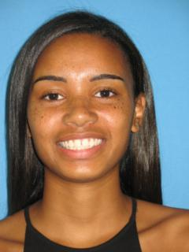
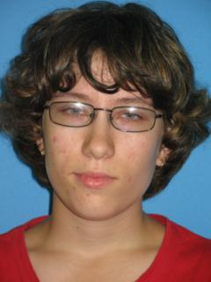
Tamlyn February (Arts and Social Sciences)
Jean-Marie does not fit the stereotype. She engages with her students and creates a learning environment where one does not have to hesitate to ask questions – there is an immense amount of comfort in her classes.
Lecturer: Ms Jean-Marie Potgieter
In her assignment about the Principles and Parametric variations of English, Tamlyn handed in an elegant assignment that exceeded my expectations. Ek is saam met jou bly oor jou uitmuntende prestasie.

Slide 14
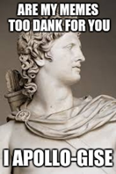

Slide 15
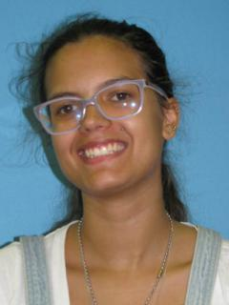
Akira Coetzee (Arts and Social Sciences)
You might not know the impact that you had on me, but you did. I had a hard time adjusting to university in the first weeks but coming to your lectures for me was like a breath of fresh air; a safe place for me.
Lecturer: Ms Amy Daniels
You are an exceptionally intelligent person. Please do not let that alone define you, for you are so much more. You are also a loyal and fierce friend, with a wonderful sense of humour; you are kind, patient, strong, and inquisitive…

Slide 16
Astrofisikus Prof Neil deGrasse Tyson:
Passion is what gets you through the hardest times that might otherwise make strong men weak, or make you give up.

Slide 17
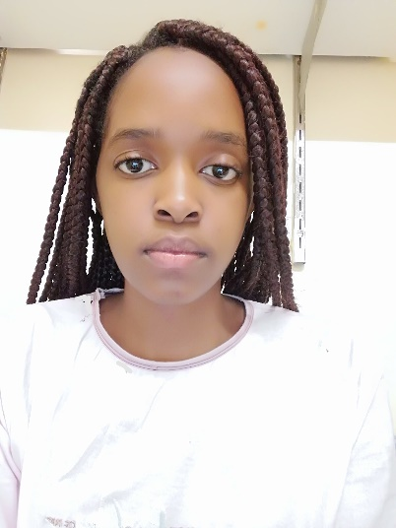
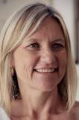
Thandeka Mchunu (Economic and Management Sciences)
Your lessons were unconventional and expanded on to more than just academics, you had a clear understanding of holistic development and its importance - that enabled me to grow, balancing my life and thus achieving.
Lecturer: Dr S Malan
Your work ethic is inspiring. Students like you make teaching a fulfilling profession. Also having been selected for the OPTIMUS programme is a wonderful accomplishment. You can feel so proud of yourself - I’m sure proud of you!

Slide 18
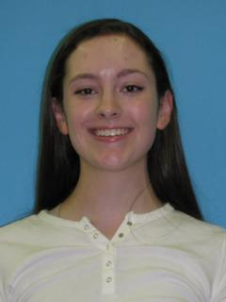
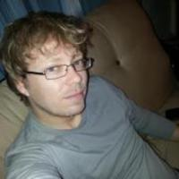
Alana Lourens (Education)
Thank you for helping me find my love for the language again, because as soon as I realized that I was more interested in languages than I thought I was, I became motivated. You made English fun, relevant and interesting.
Lecturer: Mr Jan-Hendrik Swanepoel
Her wonderful, persistent inquisitiveness which resulted in an enthusiasm, unprecedented at first-year level, to acquire knowledge. If success is indeed tied to showing up, Alana is the very embodiment of such an approach to life.

Slide 19
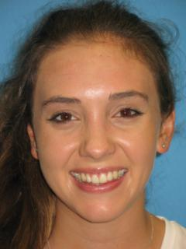
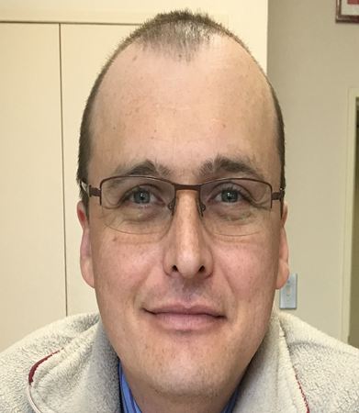
Kayla Ritchie (Medicine and Health Sciences)
Your style of questioning us in the lecture was initially intimidating but you’re never forceful or condescending. This really helped me focus and engage in your lectures and get the most out of them.
Lecturer: Dr Pawel Schubert
One of the top students of 2018 at Stellenbosch University. No mean feat of achievement. This achievement and experience should give you a boost for your future studies.

Slide 20
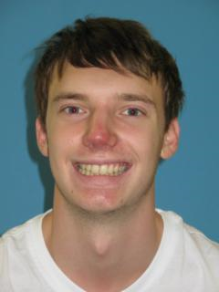
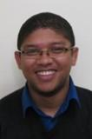
Eugène Fouché (Natuurwetenskappe)
Die gemak waarmee u ons as studente, wat almal op verskillende vlakke was, kon help was wonderlik om te aanskou. U kon ons help wanneer ons sukkel om die basiese konsepte te begryp, maar ook wanneer ons worstel met die moeiliker, tegniese vrae.
Dosent: Dr Gurthwin Bosman
Onthou om met jou maats te kommunikeer en om almal met respek te hanteer. Volgens my is dit van uiterste belang, aangesien jy hièr lewenslange verhoudings vorm. Omring dus jouself met 'n goeie ondersteuningsnetwerk en positiewe rolmodelle.

Slide 21
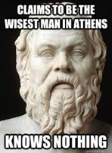

Slide 22
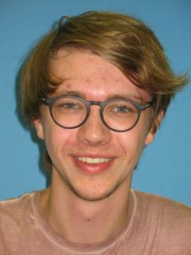
Rynhard de Bruyn (Economic and Management Sciences)
You demonstrated to me that success in a foreign language is more linked to creative, dynamic and, at times, witty and humorous expression than to the complete absence of grammatical error.
Lecturer: Dr Renate Riedner
Your contributions in class enriched our discussions and encouraged others to transcend limits. Stay curious, never stop asking questions, keep your sensibility towards others and be proud of your uniqueness.

Slide 23
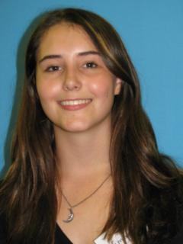
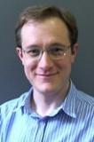
Emma Nel (Natural Sciences)
The impact [of our short time with you] had on my attitude towards Physics was significant. I appreciate the effort you had put in to give us some perspective on what Physics is actually about and also the personal motivation that you gave.
Dosent: Dr JN Kriel
Dit is werklik ’n besonderse wyse om jou universiteitsloopbaan mee te begin. Ek is ook baie bly om te hoor dat jy baat gevind het by ons Fisika modules.

Slide 24
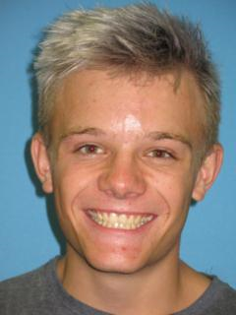
Murray Harraway (Engineering)
His confidence and his passion and love for his module would inspire us to work even harder. The content of the module was interesting, Doctor Diedericks made me hungry to learn more.
Lecturer: Dr GPJ Diedericks
I believe that you definitely have the ability to grasp the abstract and to turn them into something real. Moving between the conceptual and practical with ease will make you one of those special engineers that can think and operate inside and outside of the box.

Slide 25
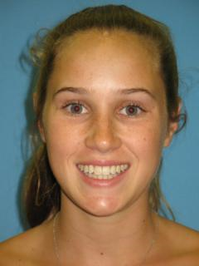
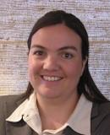
Micaela Giltrow (Economic and Management Sciences)
A person is considered influential when they make you feel worthy; give you the guidance but allow you the space to express yourself; remind you of what you are capable of without giving you a false sense of confidence.
Lecturer: Ms Monica Matthews
I was surprised, but honoured that you selected me as the lecturer who contributed the most to this achievement and I thank you for this acknowledgement. Last year was my first in my role as full time lecturer, so your nomination really does mean a lot …

Slide 26
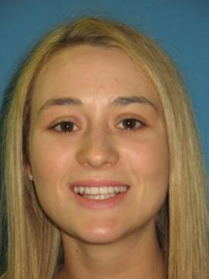
Doné Botha (Economic and Management Sciences)
You were the first lecturer who saw my potential, came to speak to me and congratulated me on my marks in your module. For me this was the first sign that I was not merely here to get my degree…
Dosent: Me Liezl Nieuwoudt
Mag jy vreugde vind in dit wat jy studeer en ek glo jou volgehoue sukses sal die regte deure vir jou oopmaak sodat jy jou volledige potensiaal sal bereik en jouself sal kan uitleef in jou beroep eendag.

Slide 27
The contents of a (wo)man’s letters are more valuable than the contents of [their] purse Lord Varys – Game of Thrones

Slide 28
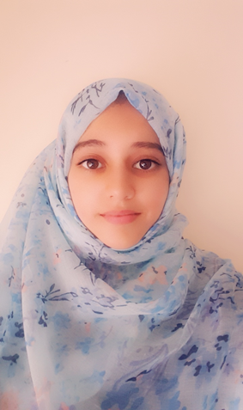
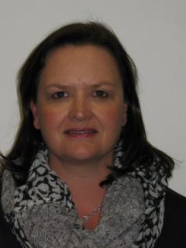
Ameera Karriem (Health Sciences)
The support that you provided to students was notable and I believe it made a significant contribution to various students’ success. After tests you would follow up on students to try and understand the challenges that they were facing regarding Pharmacology.
Lecturer: Ms Shani Dames
It is not always clear whether I succeed in this aim, and therefore I greatly appreciate your kind gesture. It motivates me to keep on going, keep on improving and actively find better ways to motivate students.

Slide 29
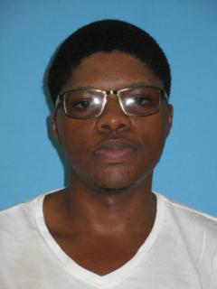
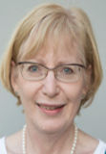
Yanga Keva (Theology)
You truly have a gift, an inexplicable ability to capture one’s mind and lead it on a path filled with a wealth of knowledge and opportunity… the passion you have overflows onto us and ignites within us a passion and desire to learn…
Lecturer: Prof A Kotzé
Thank you for your serious approach, your positive attitude and meaningful participation in class. I was always aware that you were following everything with intense interest and keen understanding.

Slide 30
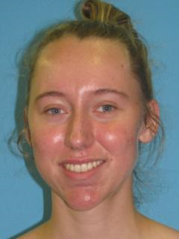
Janke van Dyk (Ingenieurswese)
U het met u uitsonderlike onderrigstyl my kennis en verstaan van die module verdiep, en my sodoende in staat gestel om die wiskunde-konsepte wat ek by u geleer het, met selfvertroue ook in my ander modules toe te pas.
Dosent: Prof Andrew Fransman
Ek het waargeneem dat jy voortdurend bereidwillig was om jou kennis met medestudente te deel en hulp aan te bied. Dit getuig van iemand met ingebore leiereienskappe, wat beslis in spanverband 'n waardevolle toevoeging in enige organisasie sal wees.

Slide 31
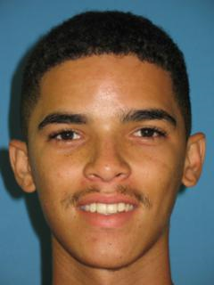
Wayde Francis (Engineering)
Being a Mathematics lecturer and lecturing Mathematics is one thing but being able to connect and actively engage in a fun manner makes all the difference, positively and to a further extent successfully.
Lecturer: Dr Jacques Masuret
You have learned to ask when you need help, help others in need and to preserve through challenging times. You have now completed chapter one and there are many chapters still to come.

Slide 32
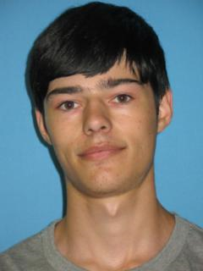
Johannes Koekemoer (Engineering)
I realize that most of my lecturers worked tirelessly towards ensuring the highest quality of education… but until your lectures I did not fully understand all the concepts. The many challenging concepts were explained very well in a very short time.
Lecturer: Dr Robbie Pott
Sustaining your thirst for knowledge, let it be a desire for improvement and development – rather than a focus on the metrics we write on paper next to your name – which motivates you.

Slide 33
Truth does not choose who it will favour:
“People often claim to hunger for truth, but seldom like the taste when it is served up.”
Tyrion Lannister – Game of Thrones

Slide 34
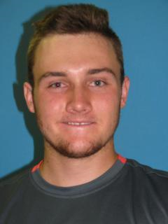
Devon Crowther (Natural Sciences)
For all the discussions we had and for all of the help you gave me throughout the year I would like to say thank you. Your talks made me more excited about Physics than I already was and that is quite an achievement.
Lecturer: Dr Gurthwin Bosman
You have bestowed upon me a great honour, in your nomination of me. I cherish it as this indicates that I am fulfilling my role as lecturer and that my actions sometimes lead to a very positive impact. It warms the heart.

Slide 35
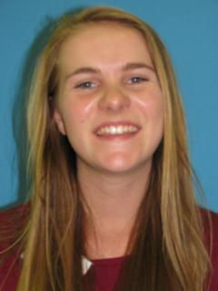
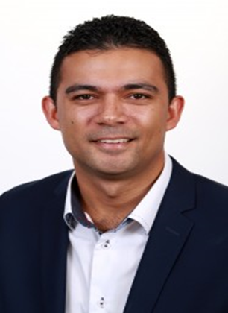
Cornelia Kritzinger (Arts and Social Sciences)
Like you, I would like to produce work which has a tangible impact on the way society interacts with the law… listening to you lecture on the Constitutional History of South Africa, I came to fully understand the true significance of the blood, sweat and tears poured into its creation.
Lecturer: Prof Bradley Slade
It is also important to acquire a critical disposition; a disposition that enables you to think of counter arguments or alternative narratives, and that always motivates you to question given and accepted knowledge.

Slide 36
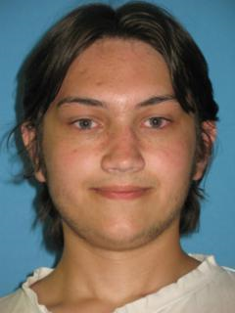
Caleb Zeeman (Natural Sciences)
One could see your love for the subject shining through in the way you explained it to us - the glimmer in your voice when you could explain the more difficult aspects, or the way you would chuckle to yourself whenever you made a small maths joke.
Lecturer: Dr Willie Brink
The experiences I’ve gained through teaching it, especially discussing theoretical and philosophical aspects of probability with enthusiastic students like yourself, deeply inspire my own research and fuel my excitement for our continent’s potential.

Slide 37
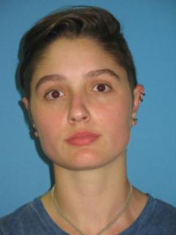
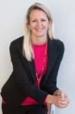
Lauren Tsafandakis (Economic and Management Sciences)
In creating such a relaxed but focused atmosphere, you allowed me to excel in the best way I possibly can. It allowed me to grasp the various concepts and techniques easily and thoroughly.
Lecturer: Ms Eloise de Jager
I even remember where you sat every day in the Financial Accounting class in the lecture hall. I believe you worked diligently and also strived to understand the subject matter, rather than just studying it.

