Slide 1
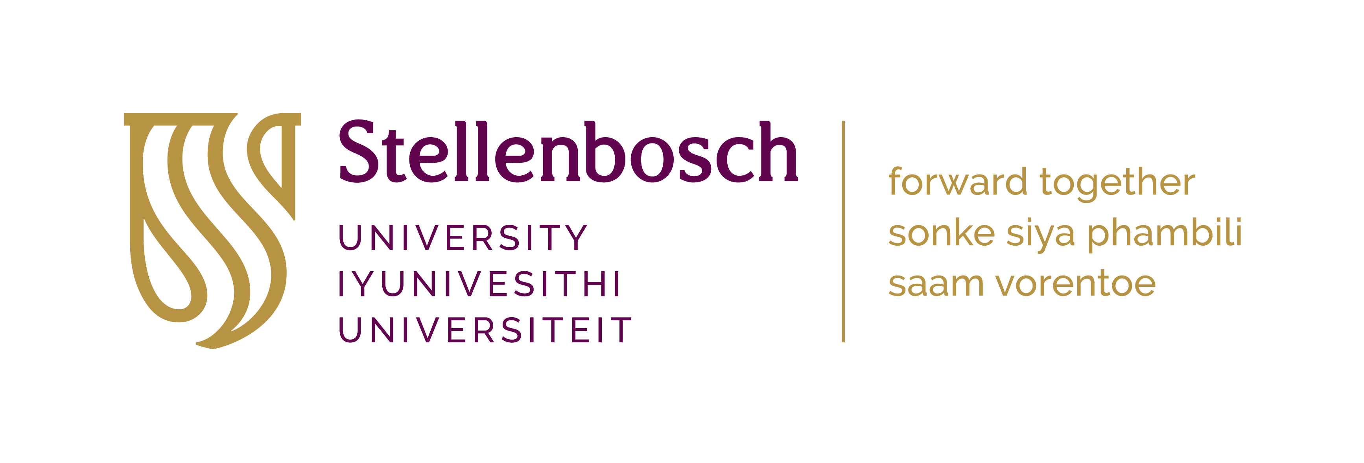
My TAU journey: a unique learning experience
Faadiel Essop
Center for Cardio-metabolic
Research in Africa (CARMA)

Slide 2
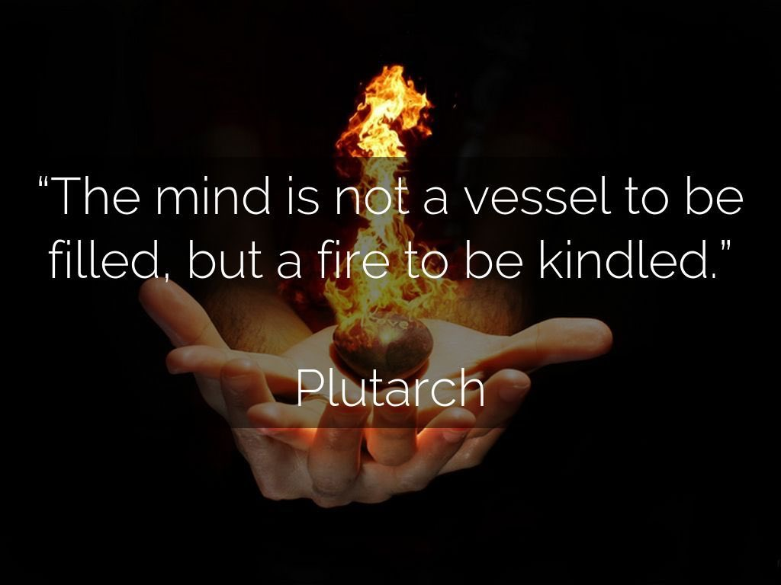
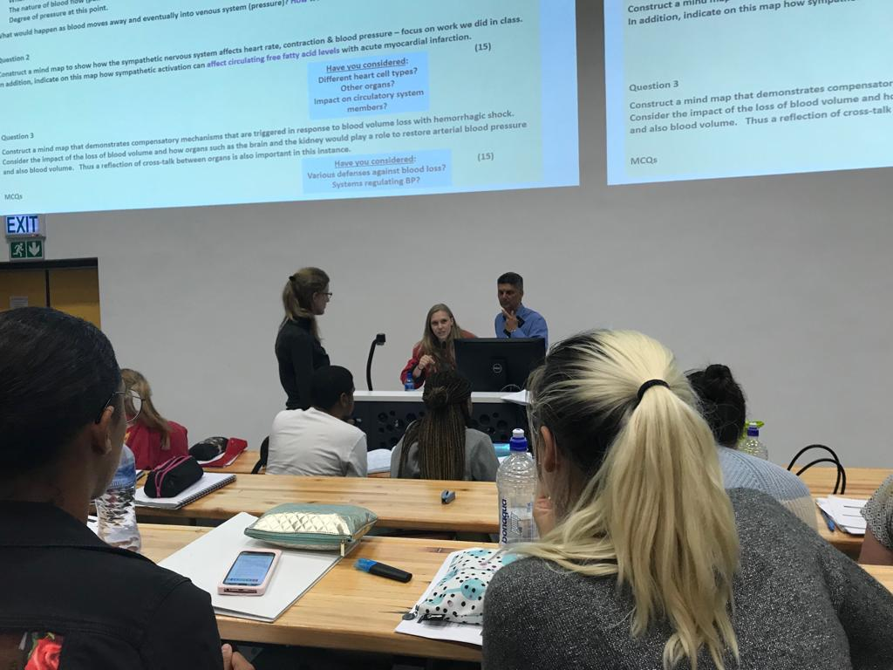
Life before TAU..

Slide 3
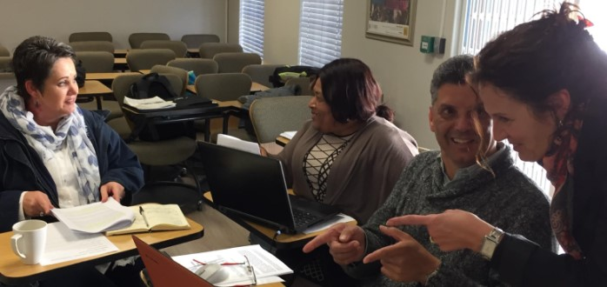
SOEL touched my T & L soul - 2019
https://www.sun.ac.za/english/learning-teaching/ctl/professional-learning-opportunities-for-t-l/soel
Whatever makes you uncomfortable is your biggest opportunity for growth.
Bryant McGill

Slide 4
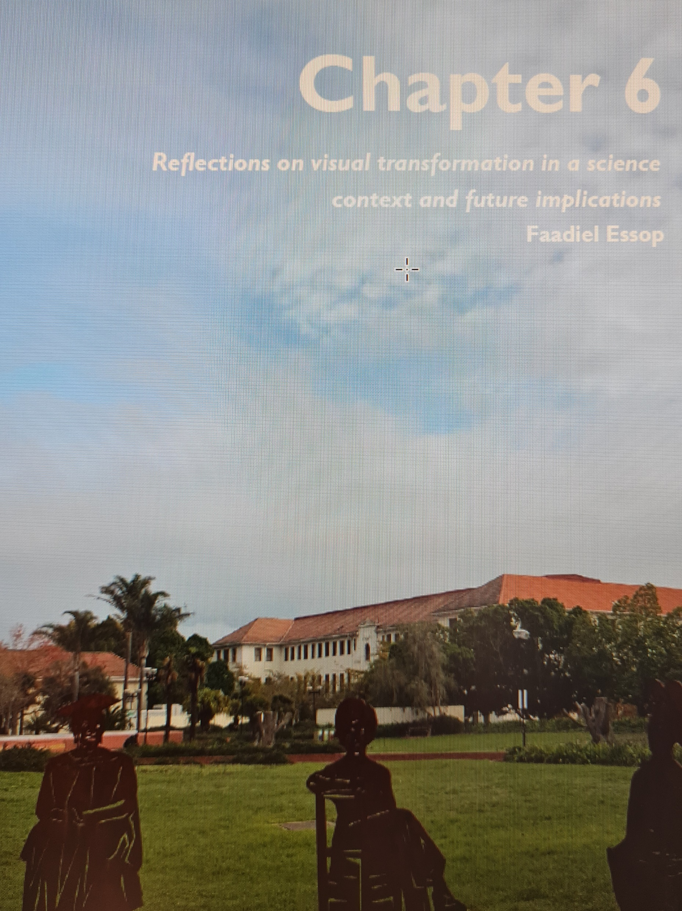
Origins of my TAU project..
‘’Scientific elitism’’
Science = neutral & devoid of socio-political & historical contexts
Strong emphasis on biological vs. human aspects
Alienation from social sciences, arts & humanities
Methodologies employed results in inflated belief & authority
versus other disciplines

Slide 5
Start of TAU journey: mixed feelings
Insecurities
TAU advisor expertise
Overwhelming
Enquiry group support
Coping with jargon
Knowledge acquisition
Workload fears/stress
Diversity of disciplines/institutions
Long sessions
Array of expert speakers

Slide 6
Latter part TAU journey: far more enjoyment
Enhanced personal relationships
Last session nice mix of talks vs enquiry group work
Better grasp of broader concepts/jargon
Project implementation & data
Impact of excellent feedback

Slide 7
Theoretical considerations: my growth
Interesting concepts that appealed to me:
The notion of ‘’slow’’ versus ‘’fast’’ science
Emphasis on social justice & how apply in own environments?
Introduction to design-based research
Triggering new thoughts/ideas/projects:
Purpose of higher education?
How actually ‘’decolonize’’ disciplines such as Physiology?
Racism and medicine/biomedical science: roots, practices, structural
Change strategies & impact:
Share & collaborate – Medical Physiology, Dept of Biomedical Sciences, 2023 plans
Interact more, break down silos – Visual Arts, Journalism, Shared Humanity, CREST, Visual Redress
Think bigger – beyond SU, IUPS book chapter
How assess long-term impact?

Slide 8
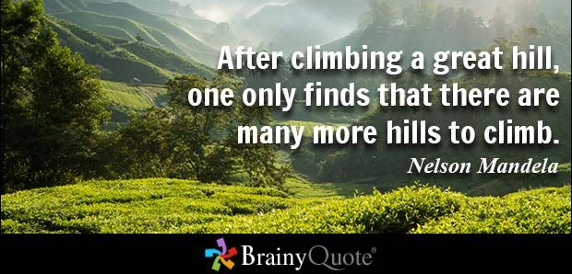
TAU journey was indeed worth it & opened-up new horizons

