Slide 1
Navies as Agents of Maritime Security
Mark Blaine

Slide 2
Contents
Introduction
Roles of Navies
  Maritime Security Matrix
  Trinity of Naval Functions
    Policing
    Diplomatic
    Military
Classification of Navies
Naval Capabilities
Limitations and Challenges to Naval Power
Conclusion

Slide 3
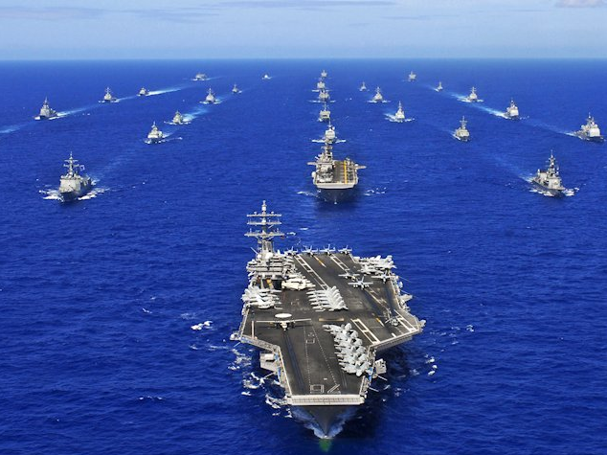
Introduction
Global maritime power vs hegemony
Since 2nd World War – USN dominance (some hegemony)
USN can exert direct and overwhelming control over any portion(s) of the ocean
Use of naval power in Gulf War 2003
  Value of naval power in world where naval battles will :most probably not be fought”
What are the uses of navies as agents of maritime security?

Slide 4
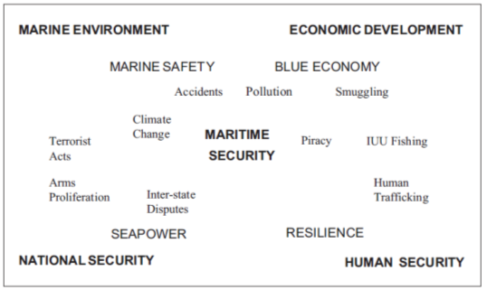
Roles of Navies
Maritime Security Matrix
  Christian Bueger framework

Slide 5
Roles of Navies
Maritime Security Matrix
  Christian Bueger framework
  Maritime security placed in centre of the matrix
    National security – survival of the state
    Marine environment
    Economic development – linked to blue economy
    Human security – also food security and resilience
    Sea power – defines the roles of naval forces
    Marine safety – safety of ships and installations
    Blue economy – linked to the economy
    Human resilience
  Sea power is important (navies are major actors in maritime security)
  Maritime security inextricably linked to economic development

Slide 6
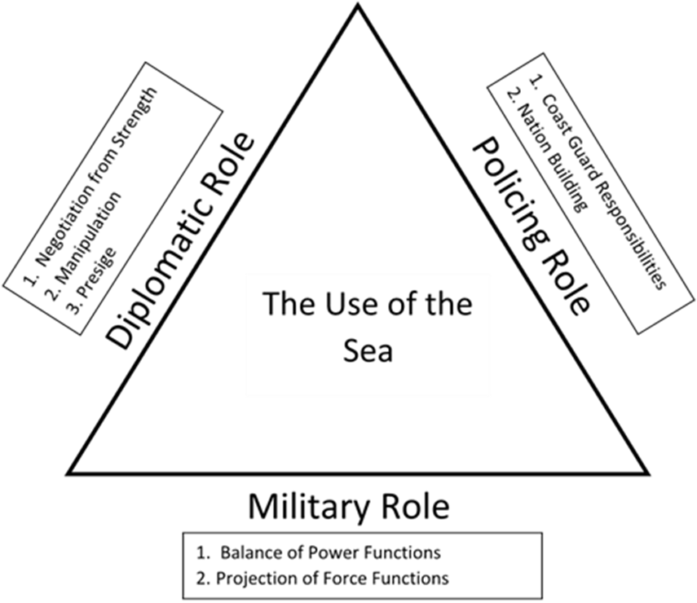
Roles of Navies
Booth Trinity of Naval Functions
  Bound by “use of the sea”
  Navies exist to ensure use of the seas while preventing others from exploiting
  Military role at base as primary role of navies
  Threaten or use force
  Different sides do not denote equal importance (fluid)

Slide 7
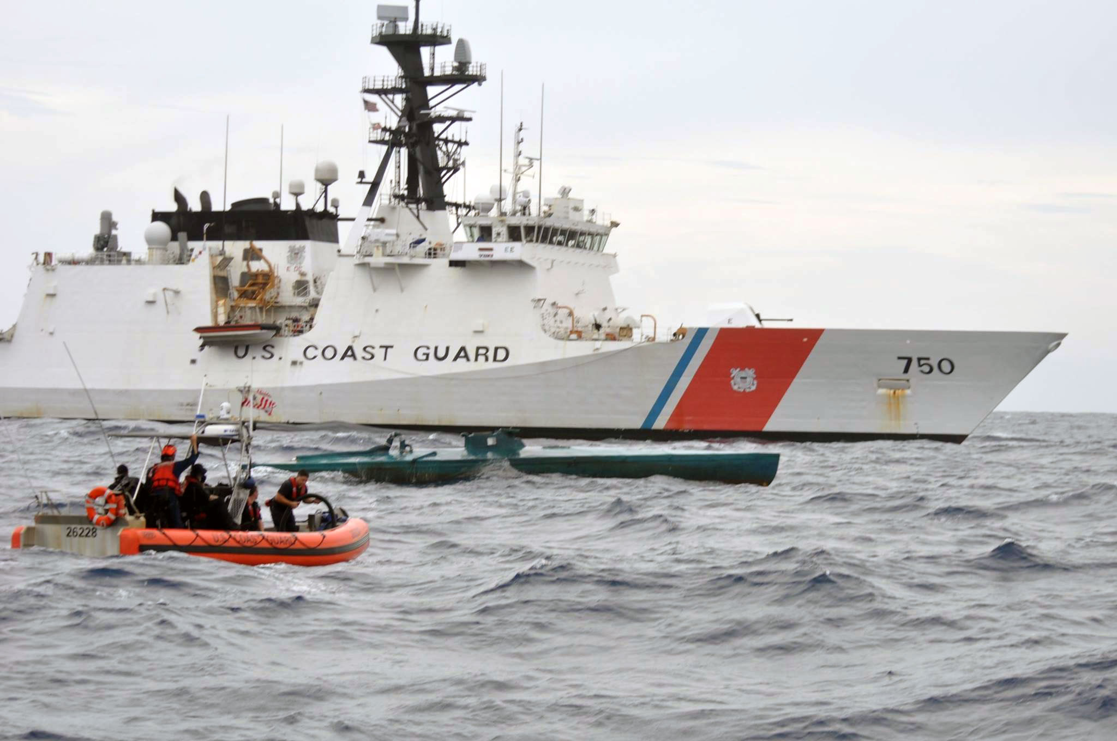
Roles of Navies
Policing Role
  Enforcing sovereignty over maritime frontiers
  Also seen as coast guard functions
  Takes place in territorial waters
  Maintenance of pubic order
  Functions
    Sovereignty
    Resource enjoyment
    Maintenance of order
    Nation building – HADR
  Not important function for blue water navies
Very important element for majority of navies

Slide 8
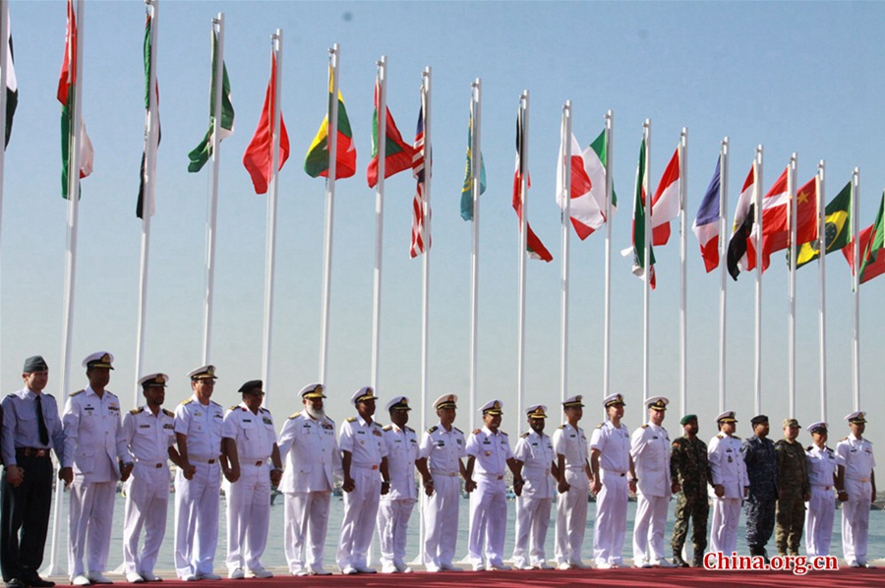
Roles of Navies
Diplomatic Role
  Supplements foreign policy
  Important role for major navies
  Explicit or implicit coercion
  Negotiation from strength
    Deployment to world oceans
    No need to employ force
    Mainly to avoid conflict
    Ability to escalate rapidly
  Manipulation
    Influencing relevant observers
    Negative or positive
    Rely on perceptions

Slide 9
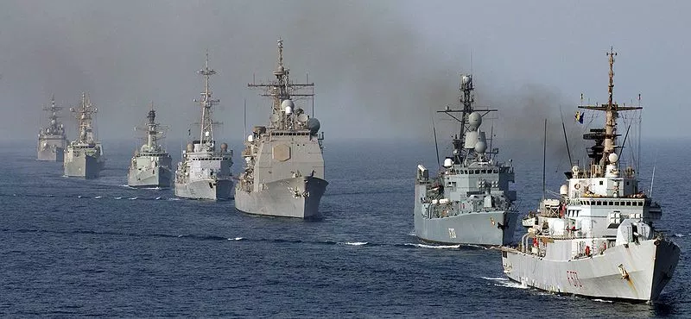
Roles of Navies
Diplomatic Role
  Assets of warships in diplomacy
    Versatility
    Controllability
    Mobility
    Projection
    Access
    Symbolism
    Endurance
  Weaknesses
    Slowness
    Inciting hostilities
    Provoking counter actions
    Need to be used in conjunction with other diplomacy functions
  Difficult to measure true success of diplomacy

Slide 10
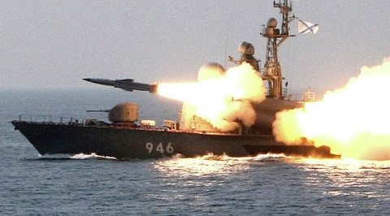
Roles of Navies
Military Role
  Threaten or use force
  Operations during peace
    Strategic nuclear deterrence – only some navies (SSNB & CVN)
    Conventional deterrence and defence – restricted to own adjacent areas
    Extended deterrence and defence – not generally blue water navies
    International order – freedom of navigation (UNCLOS)
  Operations during war
    Projection of force
    General war
    Conventional war
    Limited war
    Guerrilla war
    Vary in geographical scope and intensity

Slide 11
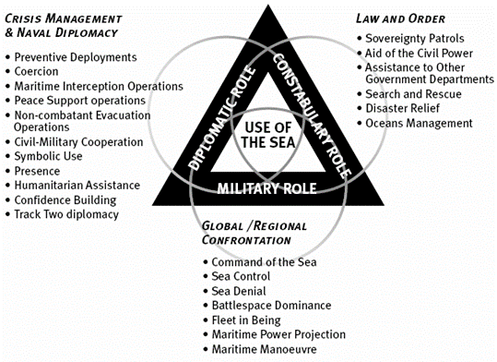
Roles of Navies
Leadmark Maritime Security Matrix

Slide 12
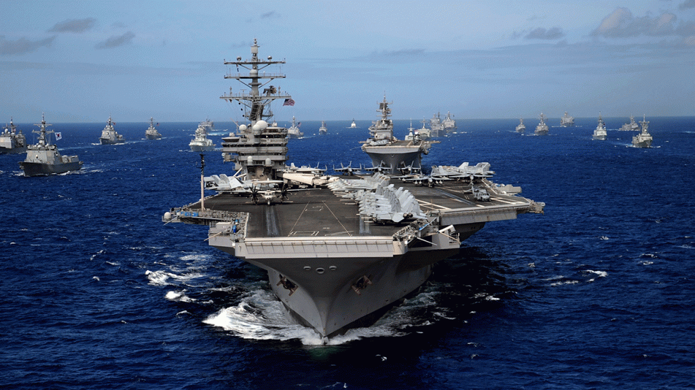
Classification of Navies
Major global force projection navies - complete (USN)
Major global force projection navies – partial (Russia)
Medium global force projection navies (France and UK)
Medium regional force projection navies (India, China, Japan)
Adjacent force protection navy (Portugal, Israel, South Africa)
Offshore territorial defence navies. (Norway and Egypt)
Inshore territorial defence navies. (Oman and Singapore)
Constabulary navies. (Mexico and Sri Lanka)
Token navies
Criteria for Classification
  Size and nature of fleet
  Geographical reach
  Function and capability
  Access to high-grade technology
  Reputation

Slide 13
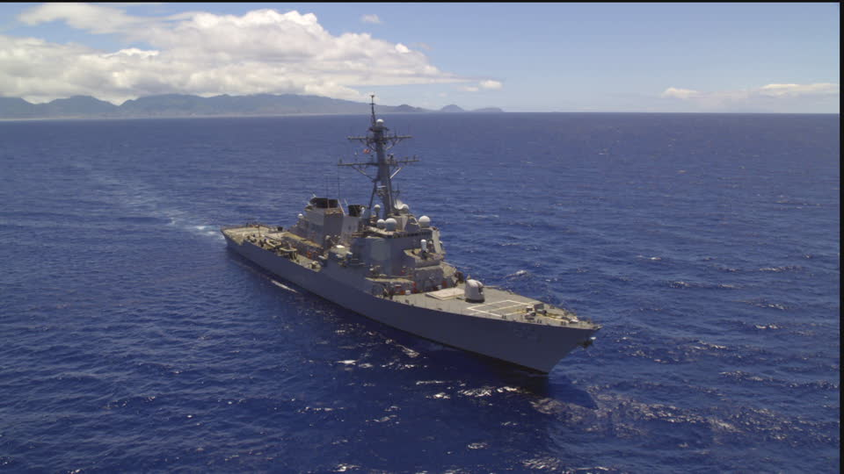
Naval Capabilities
Forward presence
  Environment and regional/local actors
  Early warning and operations away from own shores
Deterrence
  Prevention of actions due to fear of reprisal
  CVN, SSBN
Sea control
  Area operations
  Destroying the enemy, protect SLOCS, suppression od enemy commerce
Power projections
  Ability to project power ashore without harbours, etc

Slide 14
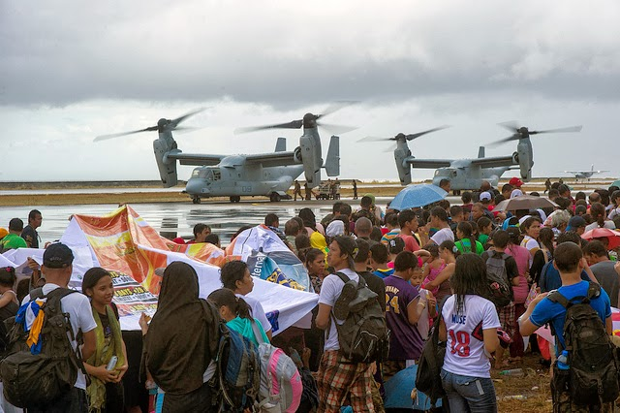
Naval Capabilities
Maritime security
  Tasks from agreed upon international law
  Good order at sea
Humanitarian assistance and disaster response (HADR)
  Human security
  Organic support elements are crucial
Modern navies
  Focus on own defences and immediate interests
Post Modern navies
  Focus on the global system and international security

Slide 15
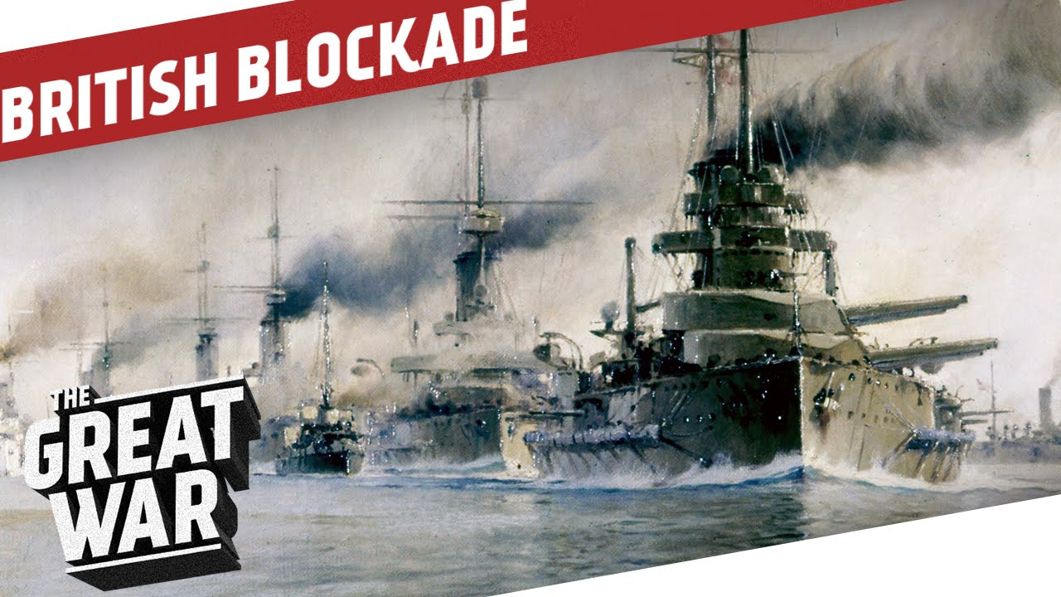
Limitations and Challenges to Naval Power
Iran detaining UK soldier in 2007
  Blockade?
  Why not?
Hegemony of USN
  Projection vs domestic invasion
  Even failure is not problematic
Hegemony has shaped secondary navies

Slide 16
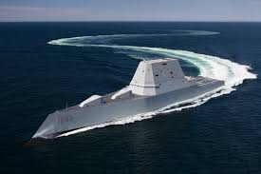
Conclusion
What use of navies as agents of maritime security?
Frameworks supplied the answers
Navies have a huge collateral value
Many navies have diplomatic and policing roles as primary tasks
Navies are very important agents of maritime security!

