Slide 2
Site specific wines driven by terroir.
Our understanding of terroir.
Our undertaking.

Slide 3
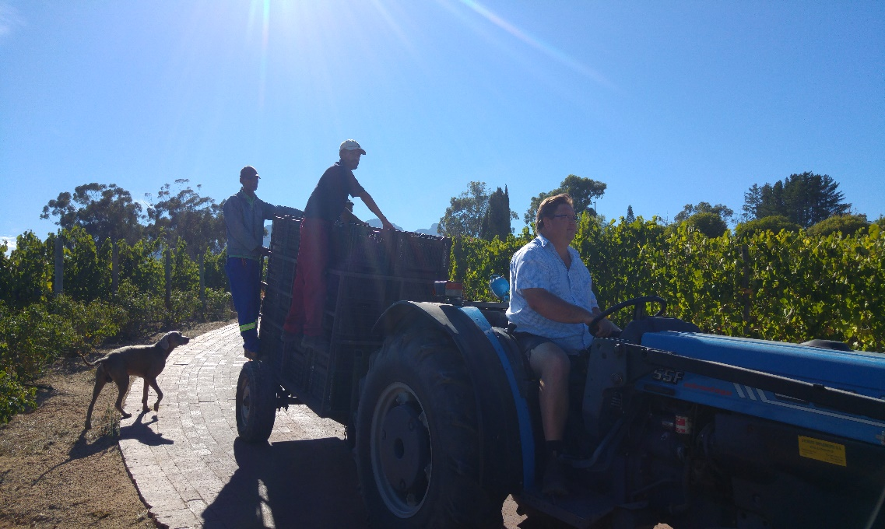
The best fertilizer is the shadow of the owner.
Our vines are cared for individually.
Top quality fruit in an environmentally responsible way.

Slide 4
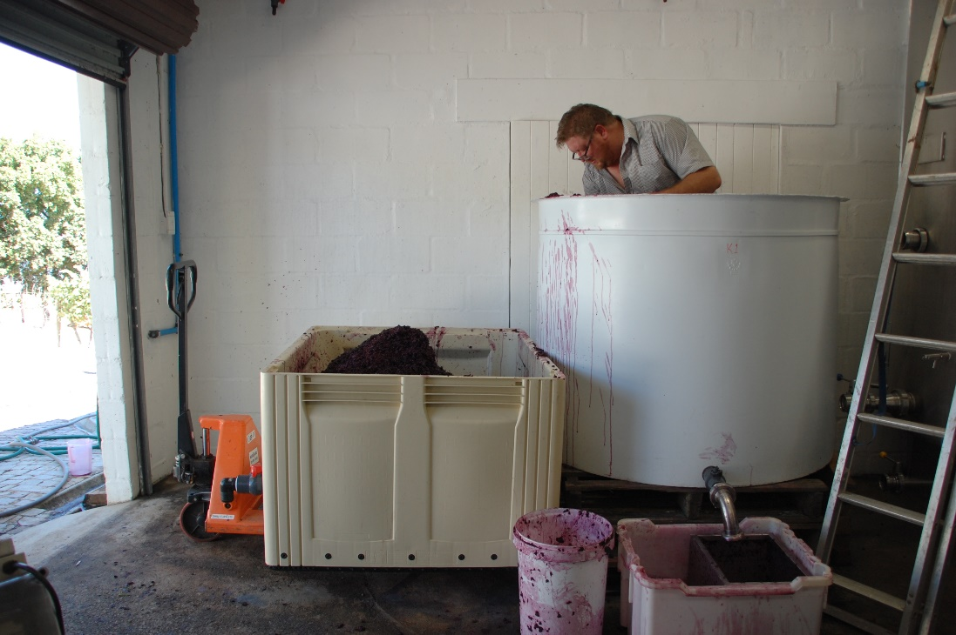
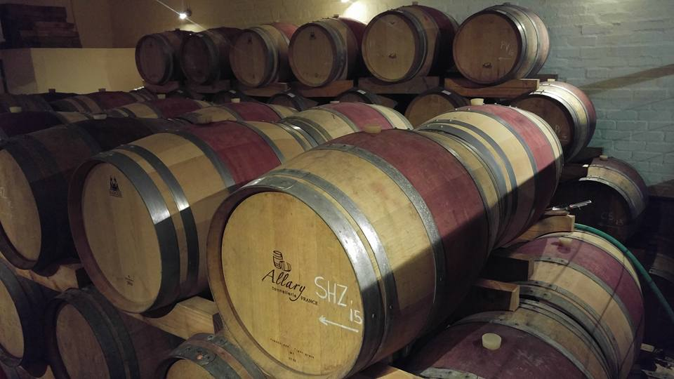
Production of approximately 30k bottles per annum.
Single cultivar wines as well as a Bordeaux and Rhone style blend.
Low intervention, handmade wines.

Slide 5
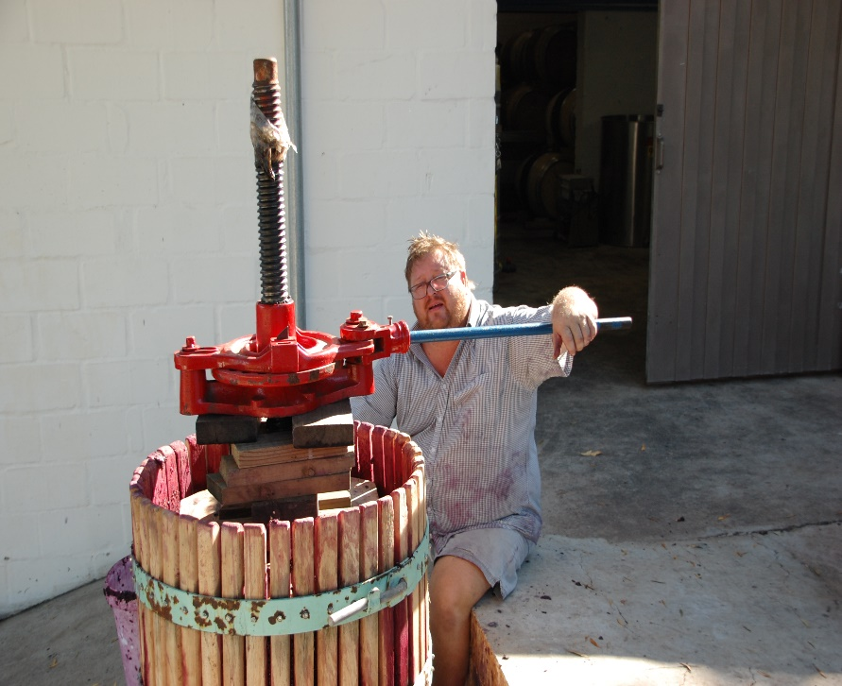
Our commitment to you.

Slide 6
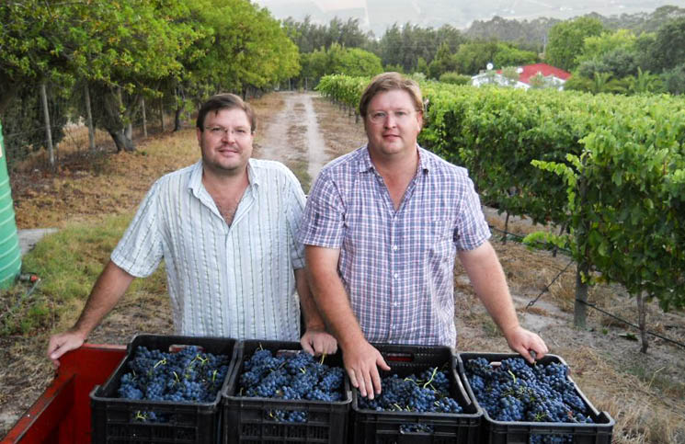
Please visit our website at www.dfwines.co.za or contact me at retief@dfwines.co.za.
Our thanks to Ambassador Maruyama and his team.
Thank you

Slide 7
Our wines
Sauvignon Blanc (Old Vines – Single varietal – Single block)
Blanc de Noir
Bordeaux blend
Rhone Blend
Mourvedre (Single varietal – single block)
Cabernet Sauvignon (Single varietal – Single block

